Slide 1
The Economic Complexity Index
Dave Gunaratnam, Haoxian Chen, Rohan Macherla, Ajit Akole, Shomik Ghose 2021
Notes:
As all of humanity continues to amass terabytes of data we often find ourselves in predicament of finding innovative ways to utilize the data to improve the way we make decisions. The creation and utilization of the Economic Complexity Index does not deviate from this common goal and in fact is an approach to use data to answer an incredibly important question: What is the optimal development strategy for a country that leads to stable growth with minimal risk to its citizens?
Hidalgo & Hussman created the quantitative foundation to begin to answer this question by creating the Economic Complexity Index. Using this metric in unison with other macroeconomic indicators we can begin to understand not only the output a country can produce but rather the capacity a country’s economy possesses. We can develop optimal paths of development for countries and suggest contingency strategies if tail events affect a particular country’s economy. The ECI captures information about an economy that traditional macroeconomic indicators do not and thus it and its derivatives serve as a useful tool in analyzing economic systems.

Slide 2
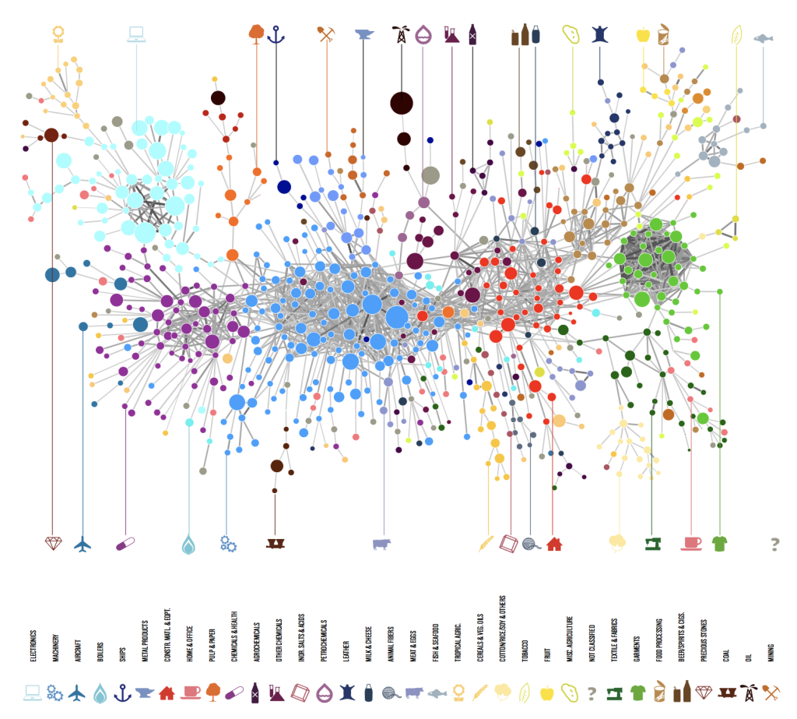
Economic Complexity - Intuition
Two Different Economic Lenses
Traditional View:
Economies are a combination of raw materials, labor, and capital that colaese to create products and services
Economic Complexity:
Products and services are actually an aggregation of knowledge that actors within an economy possess.
A breadth of knowledge allows for more interplay between knowledge sources and hence leads to more complex products
Notes:
The traditional economic view is something we are all familiar with. There are basic components that in aggregate create an economic system, namely raw material, labor, and capital. These three components are naturally measurable quantities which leads to many macroeconomic indicators to rely directly or indirectly on these particular components.
The Economic Complexity framework fundamentally changes the base unit. Within the ECI framework we view the basic unit in any economic system as knowledge. We do not mean this in a esoteric manner, rather we mean that the capacity for an economy to create output actors within the economic system must have pieces of knowledge that allow them to create value. The aggregation of pieces of knowledge that are spread across the people coalesces such that economic systems are able to create product and services. In essence we completely transform how we view a economic system. The claim of the ECI framework is that it may be more reasonable to think of a economy as a complex system where pieces of knowledge are interwoven and interconnected in a massive web. The potential of an economy is stored within this web of knowledge.

Slide 3

Consider for just a moment the knowledge needed to create toothpaste…
You probably have very little knowledge of chemical components or the properties of the substance itself.
Slowly we begin to realize that most of the products around us are created using sources of knowledge that are far beyond our own individual knowledge
The key is that each person has specialized knowledge making us in aggregate very knowledgeable
This is the defining aspect of modern society
Notes:
We realize the conception of an economic system that we’ve introduced in the previous slide seems a bit abstract so we’ll pose an example that may help concretize the ECI framework. Consider for a moment the toothpaste that you use on a daily basis. Do you know what particular chemicals are used to create it? Do you understand the properties of the components inside the toothpaste and why they are useful in context of personal hygiene? Do you understand how the manufacturing process is done or how to setup a large plant to mass produce toothpaste bottles? We could continue with this type of questioning and most of us would admit that we answered no to most of these questions. If we think a bit more we begin to realize that this type of reasoning can be applied to most of things we interact on a daily basis. Imagine the long list of questions one could ask about how our phones work!
While a quick assessment of this phenomenon may lead to believe that this is a weakness, in actuality this is one of the greatest strengths modernity. We are able to specialize and by putting together our small subsets of knowledge we are able to create very complex products and systems. Thus economies in aggregate are incredibly knowledgeable and that in essence is what ECI is attempting to measure.

Slide 4

Intuition
We are not as concerned about how much knowledge a country has but the diversity of knowledge it has and how its different types of knowledge interact
Economic Complexity then has its foundations in Adam Smith’s idea of division of labor.
Modern societies have succeeded because individuals have small but specialized amounts of knowledge, which we refer to as a personbytes.
Can we use these ideas to build an economic indicator that reflects this particular economic perspective...
Notes:
We see that there is a very stark similarity between the ECI conception and Adam Smith’s idea of the division of labor. The small pieces of knowledge that each individual has is defined as a personbyte. The aggregation of personbytes is the total knowledge of an economy. Importantly, the power of the system comes from the fact that there is a wide diversity of personbytes. Having a wide range of personbytes allows more complex interconnections between the knowledge bases and allow for the development of more complex products.
The remaining question is: how can we design an economic indicator that encompasses this economic view of knowledge-bases and personbytes?

Slide 5

Building the Economic Complexity Index
We want some type of quantitative metric that measures the amount of knowledge embedded in a country’s economy.
It should account for the different types of knowledge that people have within the economy and how those types of knowledge interact
It should reflect the actual/potential capabilities an economy possesses rather than measuring raw output
Let’s now dig deeper into categorizing different types of knowledge...
Notes:
The economic indicator that we would like to create needs to have a few key properties as we have listed above. It needs to capture how much knowledge an economy has. It must account for a vast variety of knowledge within an economy since those economies with a variety of personbytes are more capable of combining different skill sets to create a more complex products. Finally, as we have said before, we are interested in the potential of an economic system rather than the raw output. Understanding potential of an economy gives us a better idea of the types of knowledge that an economy possesses.
Before we are able to actually construct the metric we need to define a few extra terms that will assist us in the process of creating the Economic Complexity Index.

Slide 6
Tacit vs Explicit Knowledge
Explicit Knowledge: Forms of knowledge that can easily be transferred upon communication
  Ex. Today’s weather, Population of the United States, Number of planets in solar system
Tacit Knowledge: Forms of knowledge which are more difficult to pick up upon immediate communication
  Ex. How to manufacture a car, Programming an app, Learning a new language
If all forms of knowledge were Explicit, countries would be able to pick up on new skills and technologies almost immediately, thus reducing the gap in economic development
However, picking up on Tacit Knowledge is costly and time consuming
  The solution: Specialization!
Notes:
What is knowledge? Knowledge can range from anything including the results of last night’s game, to yesterday’s closing price of the S&P. It can also range to skills that we gain, whether that be how to change a light bulb, program an app, or knit a sweater! Formally, we can split the space of knowledge into two different categories: Tacit, and Explicit. Explicit knowledge consists of the pieces of information that can easily be transferred and communicated, not requiring significant effort to retain. This consists of simple facts, pieces of news, or statistics. On the other hand, tacit knowledge consists of the forms of skills and information that cannot be immediately picked up, and require some amount of time to actually pick up and retain.
This is relevant to our discussion, as for countries’ production, not all forms of knowledge are explicit. If that were the case, any country would be able to develop advanced technology, and just as easily pivot into drilling for oil, or manufacturing chemicals. In reality, the majority of industry development lies in tacit knowledge, that is costly and time consuming to pick up. As a result, most countries focus on a few industries that they already have a strong base of knowledge to implement at an efficient level. Formally, this is known as specialization!

Slide 7
Scrabble Tile Analogy
C
A
R
The more letters, the more words one can form with them -- in other words, the more capabilities, the more products a country can develop → Diversity
Longer, more complex words, are likely to be formed by less people due to the costs required to build the word -- in other words, more complex products that require a greater combination of capabilities can only be created by a smaller group of countries → Ubiquity
Individual letters represent specific capabilities, which can come together to form multiple different words, or products
Notes:
Imagine pieces of knowledge being represented as scrabble tiles, where each tile represents a specific capability of a country’s workforce. These tiles can come together to form words, which represent the actual products/industries. If a country has more pieces it can put together more words, or types of products. In other words, the country’s economy would have a higher level of diversity if it’s able to generate more products with more capabilities.
Similarly, complicated words generally require more pieces, and can only be formed by a smaller group of people (think about the tiles that would go into forming the word “Pochemuchka”, versus a word such as “run.” A Country’s ability to form more complex products that require a wider range of capabilities can be defined as Ubiquity.

Slide 8

ECI Calculation
The calculation of ECI is primarily based on comparative advantages in production.
Revealed Comparative Advantages (RCA): It measures the relative advantage of a country producing a product than other countries.
Mathematical expression:
where Xcp means the export value of a country c in product p
Intuition: A country possesses a product advantage if it produces more than a product’s “fair” share.
Notes:
The calculation of ECI is mainly based on comparative advantages of countries in producing certain products. In order to define comparative advantage, we bring up a concept called revealed comparative advantage, also called RCA. When considering the advantage of a country in producing certain product, we cannot just measure it by how much a country produces. For example, it is not fair to compare the volume of exports of a product in China with the one in Uruguay. Similarly, we also want the products taking up a large part of the world trade to represent a larger share than those with small part. Therefore, RCA measures in the following way. It measures the ratio between the share of a country in producing certain product and the share of a product in total world trade volume, which is also called a “fair” share of a product in the world.

Slide 9
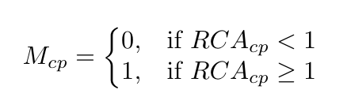
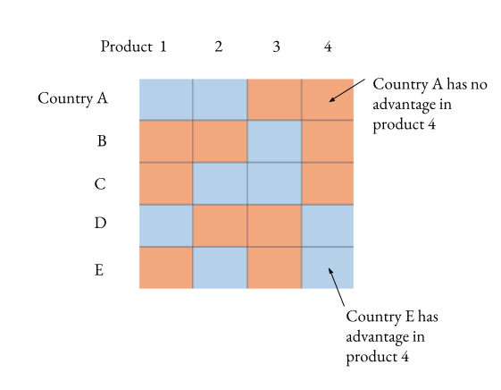
ECI Calculation
Matrix of comparative advantage: A matrix to show a holistic overview in the comparative advantage among all the countries in all the products.
Binary definition: The entries in matrix of comparative advantage are 0’s or 1’s. 0 denotes that a country does not have comparative advantage in producing a product and vice versa.
Mathematical Expression:
Notes:
Since there is a value for each country and each product, we can use a matrix to represent all the values, and the shape of the matrix is number of countries by number of products. However, a question is that even with these values, how can people measure whether a country has comparative advantage in producing a certain product. According to Hausmann and Hidalgo, who is the inventor of ECI, when the RCA value is greater than or equal to 1, we regard this country has a comparative advantage in producing this product. Similar for the other case. Therefore, eventually the matrix of RCA becomes a matrix of comparative advantage, where all the entries are either 0 or 1, representing the comparative advantage of production.

Slide 10


ECI Calculation
The calculation of ECI is based on the iterative correction between the diversity of a country product space and the ubiquity of the products that a country produces.
Diversity
A term defined for country
It measures how many products that a country is “dominantly” producing
Drawback: it cannot tell whether the products being produced are high-end or low-end
Ubiquity
A term defined for product
It measures how many countries are “dominantly” producing a product
Drawback: it cannot tell whether those countries are more or less developed
Notes:
After having a metric to measure comparative advantage in production, there are the other two essential tools in calculating the ECI of a country, which are diversity and ubiquity. Diversity is a term defined for country. It can tell how diverse it is for the product space of a country. In other words, a country with advantages in producing more products tend to have a higher diversity. Similarly, ubiquity is a term defined for products. It can tell how many countries are having advantages in producing a product. However, unlike diversity, a lower ubiquity value means better, since there are less countries with producing advantages.
However, there are drawbacks with these two metrics, even though a country has a very high diversity, it does not mean this country is so developed that it can produce many products. Similar to ubiquity. Even though a product has a very low ubiquity value, it is not necessary that this product is hard to be produced so that there are not so many countries having advantages in production. It can be a product that is been outdated. Therefore, it is not enough to just use these two metrics to tell whether a country is developed or a product is high-end or not.

Slide 11
Diversity & Ubiquity Visualization
Notes:
The picture here gives an example of diversity and ubiquity. For diversity, from the picture, we can see that Netherlands is able to produce all of the products, Argentina is able to produce the first three products, and Ghana is only able to produce the first one. Therefore, from the angle of diversity, Netherlands has higher diversity than Argentina, and Argentina is higher than Ghana as well. That means countries with more complex product space tend to have higher diversity.
On the contrary, products produced by less countries tend to have higher ubiquity. As an example, the X-ray machines mentioned in the picture has a higher ubiquity than frozen fish because there are three countries producing frozen fish but only one country producing x-ray machines.

Slide 12


ECI Calculation
Since diversity and ubiquity can speak for each other, we can create a connection between these two quantities.
Modified diversity:
Modified ubiquity:
ECI can be calculated by the standardization of solution of the equation:
Notes:
As we mentioned before, only diversity and ubiquity is not enough for telling whether a country is developed or a product is highly complex. Therefore, we also put forward the recursive versions of diversity or ubiquity. In addition to diversity itself, the recursive diversity also incorporates the information of ubiquity. So it is defined as the summation of all the products that the country has advantage in producing weighted by the products ubiquity, and then normalized by the original diversity so that the value will not be too large after many iterations. Similar to ubiquity, it is defined as the summation of all the countries that have advantage in producing a product weighted by the countries’ diversities, and then normalized by the original ubiquity. As you can see, if we plug in recursive ubiquity into recursive diversity, we can obtain an equation only related to diversity, and as N goes large enough, it becomes an implicit formula about the diversity itself. Then we can solve this equation to obtain the diversity, also the economic complexity, of a country. Mathematically, it is about solving for an eigenvector.

Slide 13
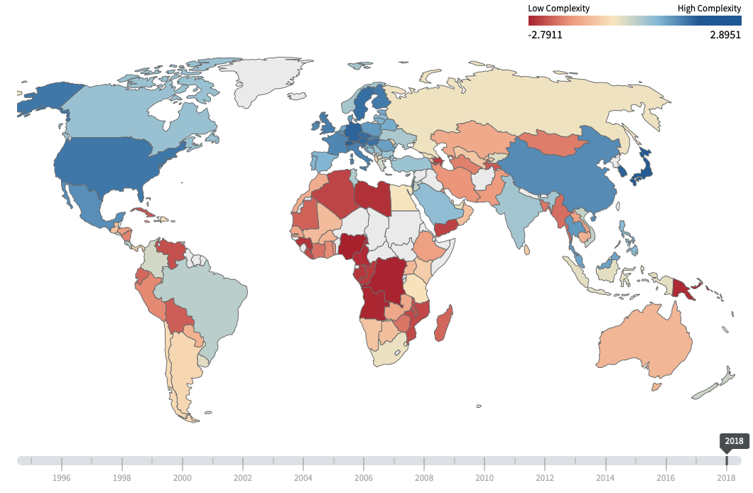
ECI World Map - Visualization
Notes:
This is a worldwide view of all the countries in terms of economic complexity. This result refers to the one in Harvard Altas Lab. As you can see, the result of ECI is still in accordance with other economic metrics, like GDP. Many countries regarded as economic entity with strong productivity have high economic complexity. Additionally, some countries with high ECI values are listed out here. Recently, Japan remains to be the top in terms of ECI. Other countries with high ECI values are like Switzerland, South Korea, Germany etc.

Slide 14
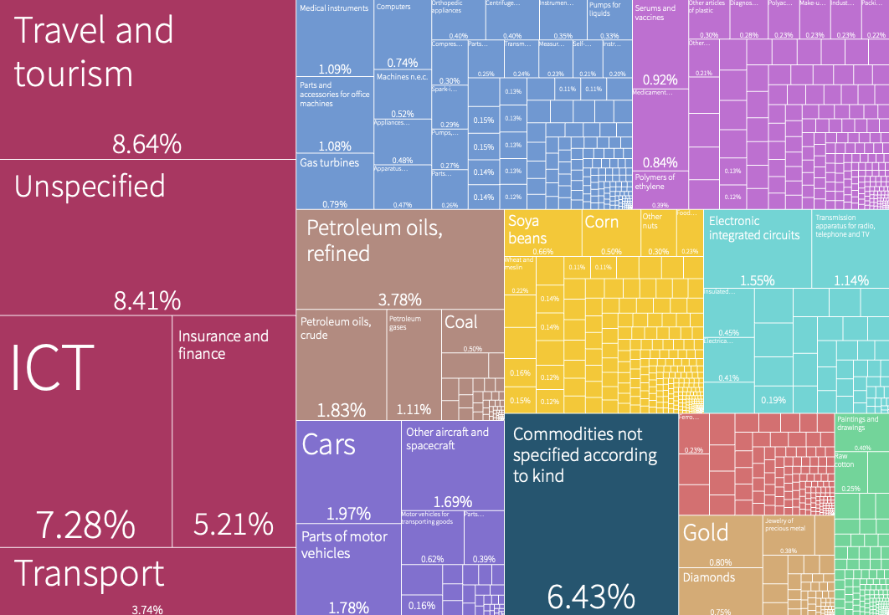
ECI - Visualization
Export of U.S.A. in 2018 (ECI = 1.55)
Export of Germany in 2018 (ECI = 1.93)
Notes:
We also provide the ECI results and their economic structure of the United States and Uzbekistan. In comparison, the ECI of the United States is indeed higher than the one of Uzbekistan. This was due to the fact that the economic structure of the United States is much more complicated, spanning across products that requires high technology like ICT (information and communication technology) and products that only needs less knowledge, like corn or soya bean cultivation. For Uzbekistan, its economic structure is a bit less comprehensive, which mainly consist of metallurgy and chemicals manufacturing. Therefore, ECI works pretty well in summarizing the economic complexity of a country.

Slide 15
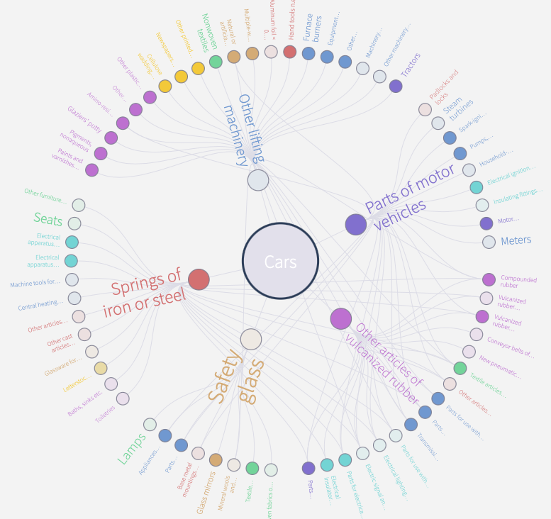
ECI vs PCI
ECI : an index measures the diversity of the products that a country produces. A country produces more products with high ubiquity has a higher value.
PCI: an index measures the knowledge contained in the production of a product. A product with more connections to the production of other products typically has a higher value.
Notes:
There is another related term called PCI, product complexity index. ECI measures the economic complexity of a country’s product space, and PCI measures how many knowledge is required for producing a product. A higher value means that it connects more to the production of other products and requires more resources for production. It is well known that cars have a higher PCI than beef. As shown in the two pictures, we can also observe that cars production indeed has a lot more connections with other products than beef production.

Slide 16
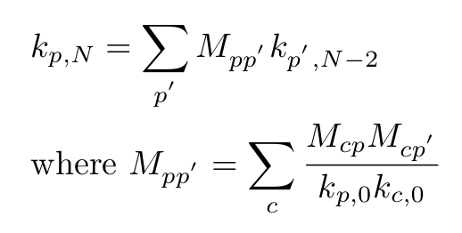
PCI Calculation & Intuition
Modified diversity:
Modified ubiquity:
PCI can be calculated by the standardization of solution of the equation:
Notes:
After we have seen the calculation of ECI, the calculation of PCI is very similar. In order to calculate the final value of the recursive ubiquity, we can solve this implicit equation. And finally the PCI is just the standardization of the solution. This problem is also identical to solve for the eigenvector of the matrix M_{pp’}.

Slide 17

Proximity & Distance Intuition
Products that require similar knowledge → More likely to be exported by a single country
This probability of two products being exported by a country, can be used to define the proximity of industry verticals
Collection of all proximities between industry groups forms a network defined as the product space, as illustrated in next slide
On the other hand, products that are far away from each other in the product space likely require very different skills to produce → Distance
Notes:
For a given economy, certain groups of products will likely require similar skills to develop. For example, the knowledge of manufacturing shirts can easily be applied to pants, but it would be much more difficult to extend the knowledge to manufacturing chemicals. This is the core idea behind the concept of proximity. Products with greater proximity are more likely to be developed by the same country, as countries will generally exploit the existing knowledge base that they have. If we were to collect all proximities between pairs of products, we can use this to build out the product space, which show us a network between various industry groups and their relative proximity to each other. The structure of this product space is incredibly important, as it shows how easy/difficult it is for a country to expand from an existing product to another vertical. Tighter product spaces imply that the country can easily transition from one industry to another. However, if the space is structured such that specific industry groups are clustered, but far from other clusters, it will be difficult for countries to uptake production in new verticals. To quantify this space between industry groups in the product space, we use the metric of distance, which is more formally defined in the next slide.

Slide 18
Proximity & Distance Intuition
How can we define proximity between countries or products in the ECI framework
A visualization may be helpful here
Notes:
As seen above, when we plot various industry groups and build a network rooted in their proximity, we arrive at a product space that shows how clustered certain industry groups are for the country in question.
Image obtained from The Atlas of Economic Complexity

Slide 19
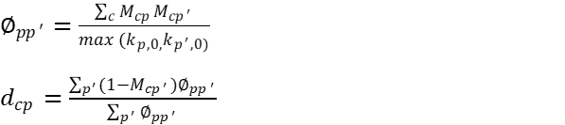
Metrics for Proximity & Distance
Formally, proximity is defined as the conditional probability of exporting p₁ given the country produces p₂ and that of exporting p₂ given production of p₁
Similarly, distance is defined as the normalized level of connectedness between a product and all other products in its industry space
Notes:
If we want to formally quantify these metrics, we see that proximity between industry verticals A and B is defined by the probability that a country will export A given it produces B and vice versa. This makes sense, as if items have closer proximity (and therefore closer knowledge required to manufacture), then a country is more likely to participate in the joint production of them.
We can then extrapolate this to distance which is a general measure of a country’s connectedness to a product. Specifically, distance is proportional to how much knowledge a country lacks to produce the product (proximity, on the other hand, is based in the knowledge actually shared among two products by a country). Thus, distance is calculated by the sum of proximities between a particular good and all the goods not being exported by the country normalized by the proximities of all products in the country’s product space. For example, if a country is already producing a lot of goods that are in close proximity to a product A, then the distance to A is small. On the other hand, if the country doesn’t produce many of the goods in close proximity to A, then the distance to A will be large.

Slide 20
Opportunity Gain and the Suggested Development Vector (SDV)
We can define the opportunity gain as being the marginal increase in complex products that a country is exposed to upon taking on the production of a specific product
  Therefore, the opportunity gain for an existing product would be 0
  On the other hand, investments in products that would lead exports in more profitable products to diminish would have a negative opportunity gain ssd
Formally, Opportunity Gain can be defined as the distance decrements in the product space from investing in a given vertical, weighted by their complexity
If we were to rank various products by their opportunity gain on a per country basis, we arrive at the definition of the Suggested Development Vector
Notes:
Just as how distance gives us an idea of how far each new product is from a country’s current mix of exports, we define opportunity gain as being the contribution of a new product in terms of opening up the doors to more and more complex products. In other words, how does an incremental investment in a certain vertical lead to an increase in the complexity of the country’s economy? Intuitively, a product that a country is currently exporting has an opportunity gain of zero. On the other hand, an investment in certain products that would lead to a relative decrease in the export of more profitable products would have a negative opportunity gain. The trade-off being made here is between advancing a new product bringing all products closer to the product space, while also incurring a cost due to the low complexity and huge distance of the product. The Opportunity Gain will go negative if the product is an extreme outlier in the product space, and is loosely connected to other products.
If we rank various verticals based on their opportunity gain for a specific country, we arrive at the Suggested Development Vector (SDV). The SDV shows us which verticals present the biggest opportunity for investment, as well as which verticals will lead to positive and negative opportunity gains.

Slide 21
Suggested Development Vector (SDV)
Sectors are ranked based on the opportunity gain of investment in each
On the other hand, we see a much higher count of opportunity gain-positive industries among developing countries such as Nigeria and Turkey, as they have more room to grow out their complexity
Nations such as Italy and Spain, which are more developed and have more complex economies, have fewer opportunity gain-positive industries, as most sectors have already been invested into (small marginal benefit!)
The question then becomes how can we generate a sequential strategy for developing nations to take advantage of high opportunity-gain sectors?
Notes:
Here we summarize the SDV of a couple of countries in the world. As expected, we see that less developed countries such as Nigeria and Algeria tend to have more industries that present a positive opportunity gain (dark green). On the other hand, developed countries such as Italy have a larger balance between positive and negative opportunity gain industries. This also means that they have a more stable and efficient economic structure, as they don’t need to transition between industries to maintain economic development. On the other hand, a country like Nigeria has many different industries that it could invest in to enhance its complexity (almost all except for one).
That being said, it is possible for a developing country to have a balance economic structure, even if their output quantities may be smaller. Similarly, a developed country can also have yet to reach a stable economic structure. However, what this result serves to show is that we can potentially use economic complexity as a macroeconomic indicator, one that not only describes the quantity but quality of economic progress.
The differences in economic structures for developed and developing countries suggests that we need a model for analyzing development at different stages. Is there a sequential strategy that can walk through changes in the SDV and overall structure of an economy as countries invest in specific industries? How can we use this to maximize growth for developing countries? Similarly, for already developed countries, can we use this information to understand how shocks to specific industries can affect development, and what strategy should be adopted by countries in these situations?

Slide 22
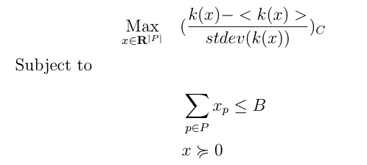
Budgeted Greedy Development Strategy
SDV is a qualitative method, which can be used to uncover products helpful for ECI improvement.
Budgeted Greedy Development Strategy is a static quantitative method, which can be used to solve a budget allocation portfolio to improve ECI.
  Given the budget of investment, we formulate an optimization problem as follows and want to solve for an optimal budget allocation:
where B is the budget, P is the product space, k(x) is the eigenvector associated with the second largest of MCC' after adding x to the original export vector, C is the country we are interested in.
Notes:
SDV is a helpful approach in order to find out potential products to build up a country’s economic structure and improve its ECI. Therefore, it helps us to evaluate whether increasing investment into a certain product would result in an ECI increment. However, it does not tell us how much a country should invest. Also, a common situation is that the budget for investment is usually limited. Therefore, according to this question, we formulate an optimization problem where we want to find out an optimal investment portfolio such that the ECI can be maximized and simultaneously, the budget is limited.

Slide 23
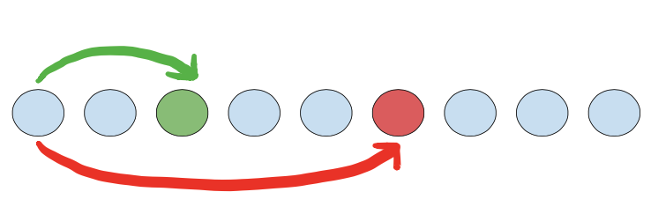
Budgeted Greedy Development Strategy
The problem is hard to solve because it is non-linear and non-convex.
One idea to obtain a near-optimal and feasible solution is to use Greedy Algorithm.
Algorithm abstract:
Divide the budget into multiple parts (shares).
For each part, search for the product that can result in an activation and maximize the current ECI. If there are no activations for all products, we increase one share.
If we find there is an activation, we can still keep looking for the next activation, and calculate the ratio of ECI increment to budget used. This step depends on how many activations we want to foresee.
Notes:
However, this problem is not easy to solve because even though the constraint is linear, the objective involves complicated calculations, and it is even non-linear and non-convex. In order to solve this optimization problem, we develop a new algorithm based on Greedy algorithm. Basically, greedy algorithm is just about choosing a solution that can maximize the objective function at the current point. Therefore, in our cases, we separate the budget into multiple smaller shares. And for each smaller share, we loop through all the products and find out the one that can maximize the ECI increment if we invest this share into this product. Then for each share, we can do the same thing and eventually find out a near-optimal solution. However, it is quite common that a share is not enough for making ECI increase; therefore, we can try to keep adding up multiple shares until we find an increment.
In order to avoid local maximum, we can also keep looking for the next increment, and compare with the two increments by calculating their ratios, which is the ECI change over the budget used. In addition to two increments observation, we can also observe more increments further, but this will also lower the computational efficiency.

Slide 24
Why do we care about sensitivity analysis?
So we’ve created this ECI metric but we haven't built any intuition about its behavior under perturbations.
We’d like to understand how changes in the export data can change a country’s ECI score.
Is the ECI rank of a country very sensitive or insensitive to changes in a particular industry or group of products?
Notes:
The creation and calculation of any quantitative metric warrants the following question: what would happen to the metric if I perturbed the inputs? Understanding the sensitivity of your metric allows an analyst to understand the driving forces beneath the metric itself. An analyst will be able to know which inputs are key in the construction of the metrics and which ones do not affect the final result as much. In our case this is a very useful type of analysis. Sensitivity analysis allow us to answer the fundamental question, which industries are key in driving up the ECI score of a particular economy? Understanding this allow us to see which industries are important for the development strategy of an economy and gives a bit more insight into how we may intelligently design a development strategy that keeps this industry stable.
Sensitivity analysis can also be viewed from the standpoint of risk. Will drawdowns in particular industries cause large shocks to the ECI score? Which events should a country avoid at all costs? Will a 20% drawdown in High Complexity Products affect an economy as much as a 20% drawdown in Manufacturing. Understanding sensitivity and performance metrics allows us to better assess the risk profile of a country. We would like to be able to categorize whether a country has a stable ECI or an unstable ECI score through doing this type of analysis.

Slide 25
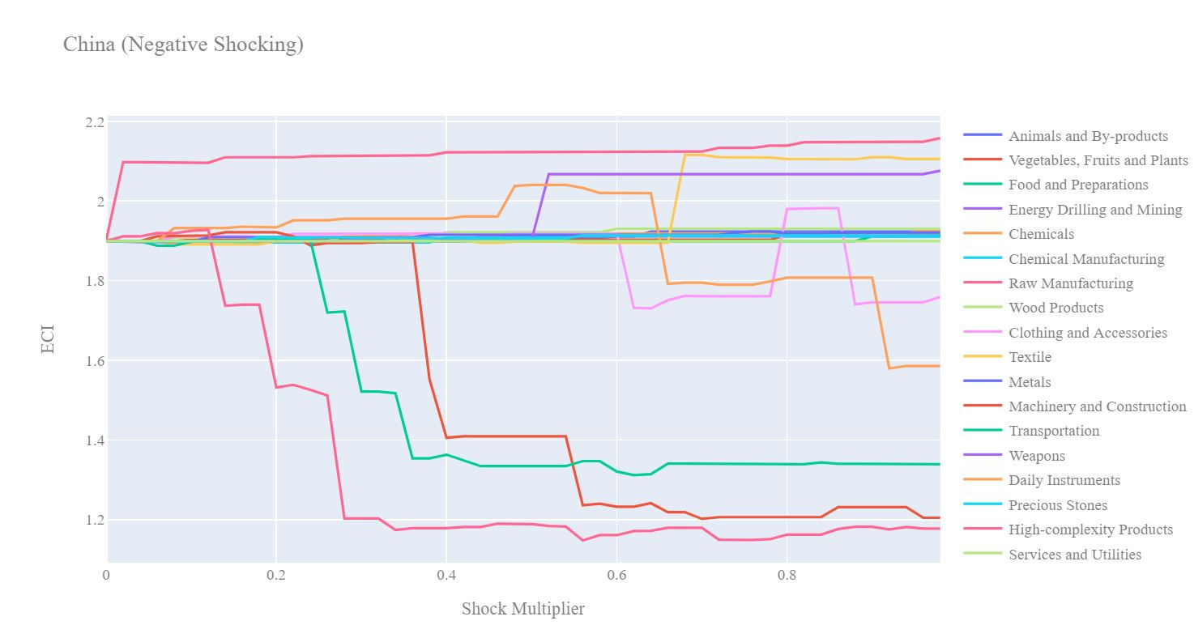
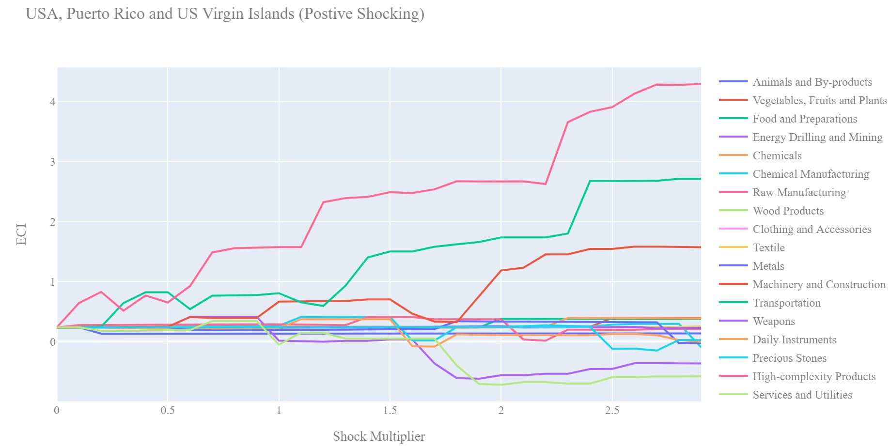
Sensitivity Analysis
The broad aim of the sensitivity analysis section is to understand how sensitive a country is to instantaneous increments or decrements in export levels in various industries
Two areas of analysis:
the stability of a country’s ECI with respect to shocks in underlying export level
the sensitivity of a country’s SDV to changes in export level
ECI Sensitivity Analysis is conducted on all countries while as SDV sensitivity analysis is conducted on developed countries with well-diversified economies.
Notes:
So how do we conduct our sensitivity analysis? We generate two separate charts for each country. In chart one we positively perturb the export data for a particular country for x% at very small increments. In the second chart we negatively perturb the export data for a particular country for x% at very small increments. This allows us to visualize how small drawdowns in an industry may affect the ECI score as well as very large drawdowns. This is done for every industry group for a country. Interestingly, some patterns begin to emerge as we study these sensitivity charts. Firstly you will notice that often a hockey stick or upside down hockey stick shape will occur. This suggests that while an drawdown or increase in export of an industry may lead to an immediate change in ECI score after awhile the ECI sore plateaus and changes in the export level no longer affect the ECI score. In the positive shocking case the interpretation of the corner point of the hockey stick is that this is maximum amount an economy should invest in an economy since after that they will likely experience diminishing returns. Often we also see that decreases in export for certain industries actually increases the ECI score! This suggests that this industry is actually keeping the ECI low and it would be better if that nation did not focus its efforts on expanding that market sector.
Until now all of our sensitivity analysis has been done by in some sense treating each industry independently. Our shocking charts are created based on the assumption that an industry is shocked by x% given that all other industries are held constant. This obviously is far from the economic reality. Modelling the interrelationships between industries would be a challenging task in itself but something that would be worth analyzing.

Slide 26
Contingency Strategy
Essential Question: How should a country react to drastic drawdown in exports from a important industry?
When sudden geopolitical, or economic factors cause downturns, through the lens of ECI, we can suggest the industries that are optimal to invest in to maximize a recovery
Intuitively the country should invest stimulative capital into industries that will “open as many doors as possible” into even more promising industries.
Notes:
All economies must be prepared for the worst case scenario in which, geopolitical disasters, natural disasters, etc. completely destabilize the entire economic system. In situation like that countries must be at the ready with a strategy for recovery. Using the ECI framework we are able to suggest the optimal blend of industries that would lead to the fastest ECI growth and thus economic recovery.
We conduct this analysis by shocking the export data down by 60% for all key industries of a country. Then we can recompute the Suggest Development Vector(SDV) for each economy and output the top three industries that would lead to the largest opportunity gain. The idea is that these industries would be the best for an economy to invest in and subsidize in a disastrous scenario so that a recovery can be achieved in the smallest amount of time.

Slide 27

SOI
How do we measure the effectiveness of our suggested development vector?
We define the Structural Optimality Index (SOI) as the R-Square obtained from regressing the country’s actual development over the suggested development strategy.
Actual development is quantified in terms of the export increase in major industry groups, and suggested development is represented by the opportunity gain of developing in specific groups, as previously calculated
This gives us a way of quantifying how the actual path of development adopted by a country lines up with the suggested path that we uncovered
Notes:
Our Suggested Development Vector is a strong roadmap as to how countries can improve their growth using ECI, but the question remains how effective this strategy is when compared to the country’s existing development strategy. To address this, we introduce the Structural Optimality Index (SOI), as being the R-square coefficient between a country’s realized development path and the suggested development vector.
Similar to SDV, we calculate actual development based on the marginal export increase in specified industry groups. This is very similar to the suggested development vector, which is also a marginal gain from developing in specific groups as per the ECI. In doing so, we are able to obtain a metric that extends our theoretical analysis to one rooted in the country’s actual development. A higher SOI is indicative of a higher degree of correlation between our suggested path and a country’s actual development.

Slide 28
Comparing ECI with other Macroeconomic Metrics
We also want to understand how well ECI lines up with existing Macroeconomic metrics
Solution: Regress SOI with other Macroeconomic metrics!
In fact, when we regressed net increase in GDP over 5 years with the SOI, we achieved a strong positive correlation that was significant at a 1% level
This shows that development based in complexity translates over to increases in GDP
Notes:
Because SOI is defined by a country’s real output, it can be used as a macroeconomic metric for countries. To show this, we compared SOI with other macroeconomic indicators, such as GDP. In fact, after regressing SOI with the 5 year net increase in GDP for 106 different countries, we obtained a strong positive correlation, significant at the 1% level. Not only does this show that SOI can be used as an accurate macroeconomic metric, but it is also important as it proves our hypothesis that the more a country develops as suggested by calculations on a complexity level, the better economic outcomes it will achieve. In other words, ECI-based development can translate over to increases in GDP. By following a strategy outlined in the SDV, not only will countries enhance their complexity, but they will be able to achieve higher levels of economic output as measured by GDP.

Slide 29

Understanding ECI for Economic Blocs
Our approach to ECI and optimal development strategies changes when we look at countries as a part of larger economic blocs
Countries will rarely develop industries in isolation – in reality, their existing trade relationships must be taken into account, which suggests that a path optimal for a bloc may be the most practical choice
ECI, as well as GDP, becomes a weighted average, which means that suggested development and budgeting paths will be those which lead to the optimal mutually beneficial result
Notes:
In reality, however, countries rarely develop in isolation – rather, they rely on existing trade relationships with partnered countries to also sustain their development. As a result, it may make sense to also study how the paths suggested for optimizing the complexity of a nation change, when we look at the larger economic bloc as an entity.
In regards to our approach, little changes, except for the fact that we treat the entire bloc as a single nation, with its economic exports and GDP combined. Mathematically, this means that quantitative metrics such as the raw ECI scores will be weighted averages of the constituent nations. As we then build out a suggested development vector, as well as sensitivity strategies, we see that the ultimate output is one which leads to the optimal mutually beneficial result. This means that the suggested path for the bloc may not necessarily lead to the most optimal solution for an individual nation

Slide 30
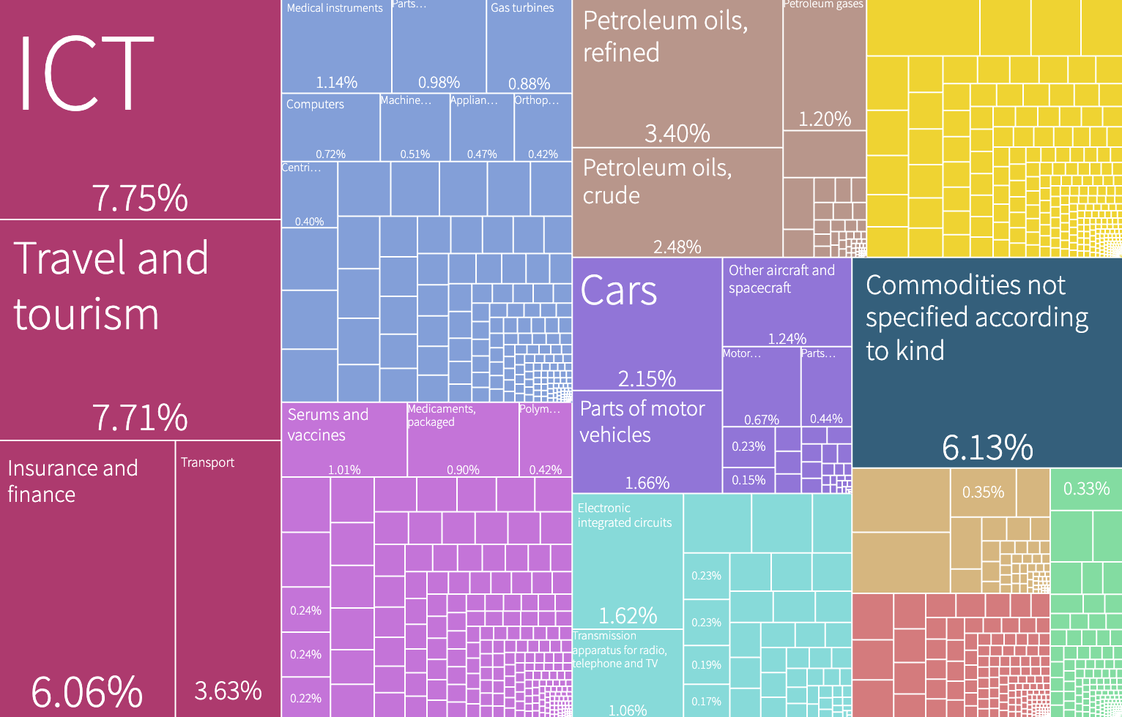
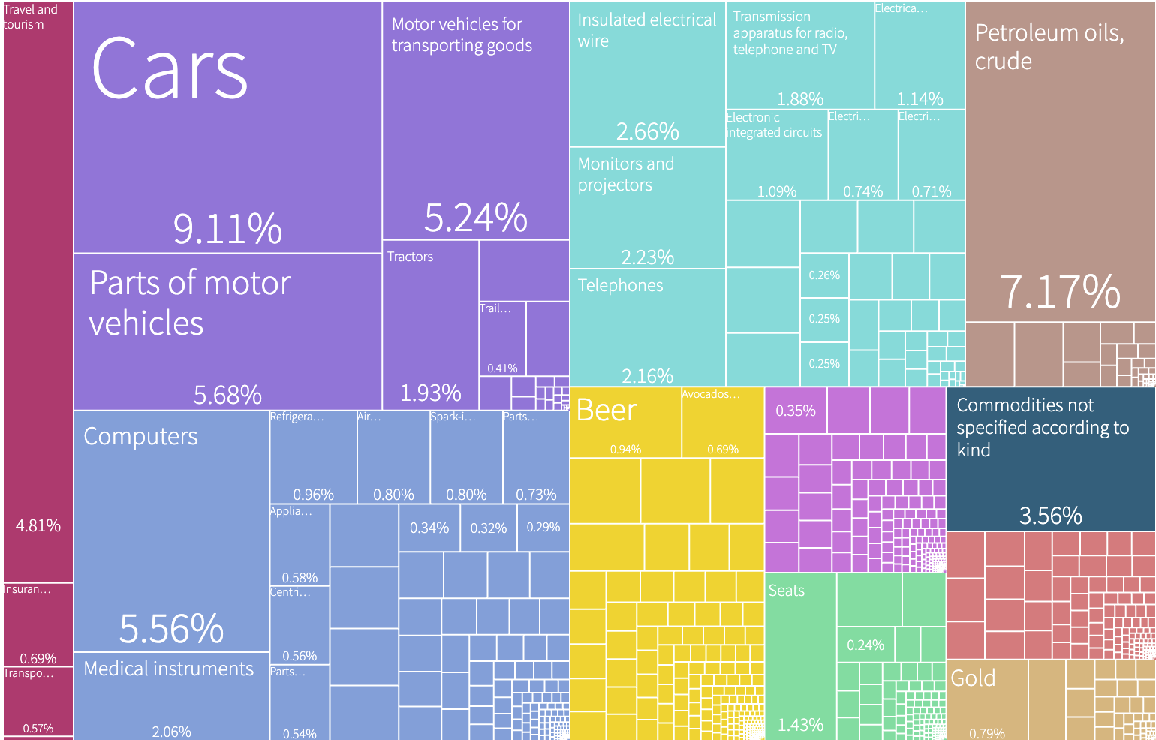
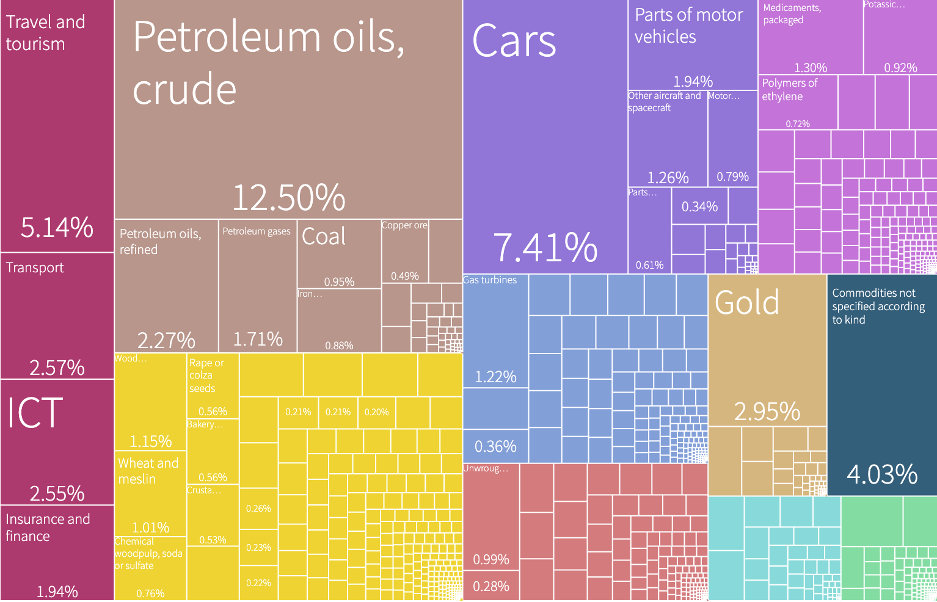
Economic Basket of a Bloc
United States
Mexico
Canada
Notes:
If we take a look at the USMCA (United States, Mexico, Canada) trade bloc, we see that the respective countries’ economic output is quite different from one another. Each country seems to have a fairly high level of complexity, but has a competitive advantage in different industries. As a result, the suggested path for the bloc will likely lead to a fairly unique strategy that would not be applicable for any individual country. However, when taken together, it can lead an alternative path of development that could lead to optimal mutual development.

Slide 31
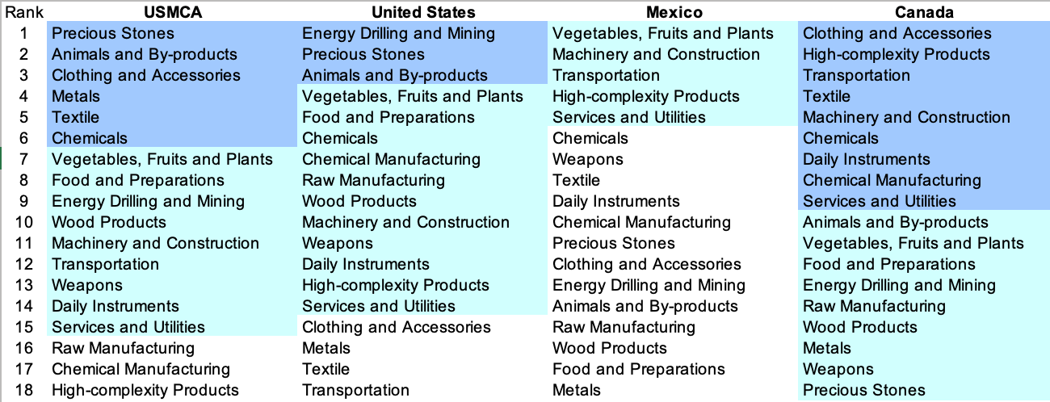
Relative Suggested Development Vectors
Despite decreasing for Canada, the number of positive-opportunity gain industries increases for both US and Mexico, opening more paths for gains for both countries
Notes:
For example, if we look at how the suggested development vector changes, we see that the number of positive-opportunity gain industries for the bloc as a whole increases for the US and Mexico, but decreases for Canada. This makes sense, as both the US and Mexico have a low level of positive opp gain industries, whereas Canada has a higher level. If we apply the aforementioned methodologies to build an SDV for a weighted average of these, we arrive at a strategy with more paths for gains for the US and Mexico.

Slide 32
The Limitations of the ECI framework
Q1: Does export data fully capture the knowledge that is embedded in an economic system?
ECI truly tries to measure the capabilities that an economy has in aggregate, but they are, by definition intangible. The ECI solution is to proxy knowledge with the complexity of products, however services that a country provides also carries information about the knowledge embedded in an economy. Unfortunately the data only reflects exports of tangible products.
Q2: Does the binary definition of the Mcp matrix introduce a limitation in the analysis?
The way in which we define the Mcp matrix is by denoting whether a country has or does not have a relative comparative advantage in the export of a product. The binary nature of this measure in some sense throws away much of the information we collect from the export data set. While it is useful in terms of defining an adjacency matrix of a graph, we may be able to get further insights if we loosen this restriction.
Notes:
While the ECI framework brings with it an entire new quantitative methods of analyzing economic systems, there are a few very obvious limitations that would be great to address in later developments. Firstly, as explained previously, the ECI metric uses products that an economy produces as a proxy for knowledge. The more diverse personbytes of knowledge contained in an economy, the more complex the products an economy can produce. The problem is that tangible products are not the only outputs of a well developed economy. Services are often a large part of the export of a particular country however we do not have a good data source that includes the export of services. Thus we may be missing a large part of the capacity of an economy since we have no way of measuring the complexity that comes from non tangible products.
The second limitation of the framework is the design of the Mcp matrix. Remember the Mcp matrix defines whether a country has a relative comparative advantage in a matrix industry or not. In essence each entry is a binary variable. While this has nice interpretation in terms of adjacency matrices of a graph, it imposes restrictions on our analysis that could be avoided. In some sense whether or not a country is successfully engaging in a particular industry cannot be sufficiently reflected in a binary measure. We need to more informative measure to define a relative comparative advantage. However then we loose the interpretation of a 1 representing an edge between the country and product in our bipartite graph. Some mathematical analysis needs to be done to make this change commensurate with the ECI computation.

Slide 33

ECI Possible Improvements
Idea 1: Convert to a continuous scale for the Mcp matrix.
While moving away from the binary nature of the Mcp matrix seems like an interesting avenue, understanding its implications in the rest of the mathematics that is done to compute the ECI score is not trivial. Some theoretical issues needs to be considered in terms of tractability in order to show that conversion to a continuous scale results in a sensible metric. The authors of the ECI+ paper explore this issue and create a new metric they call ECI+
Idea 2: Alternative strategies for budget allocation.
Currently, our budget allocation strategy is based on a greedy approach, which not guarantee optimality; additionally, the algorithm itself currently has an incredibly inefficient runtime, which is why we would look for alternative approaches which can approach optimal solutions with a lower runtime. Specifically, we would look to build a dynamic programming-based approach to budget allocation.
Notes:
As we noted in the previous slide, converting the Mcp matrix into a continuous scale would in fact make our analysis much more expressive and allow us to squeeze more value out of the data that we are collecting. Again theoretically we are unsure if this is tractable but it is something that other teams have looked into. Most notably a recent paper on ECI+ seems to address the binary nature of the Mcp matrix.
Finally, throughout this analysis we have thought of countries as independent entities that are unaffected by the actions of other countries. This of course is a massive oversimplification. We believe that the biggest improvements to the ECI framework could be made if we were able to somehow incorporate the relationships between countries into our analysis to further understand how interactions between countries affect their ECI score. This type of augmentation could be useful in our greedy development strategy or our sensitivity analysis. In fact this may be an interesting application of game theory.

Slide 34
https://kachanilab.ieor.columbia.edu/
2021

Slide 35
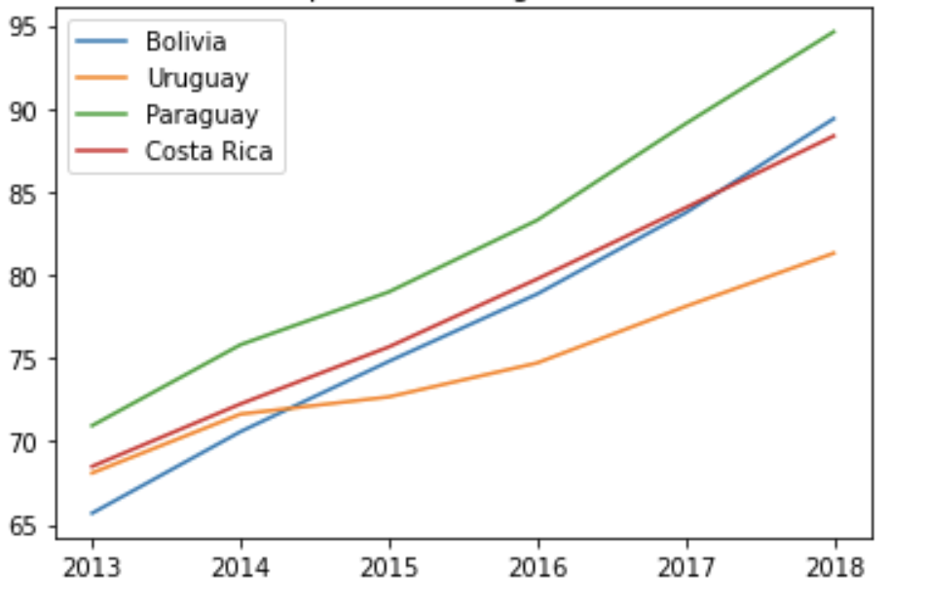
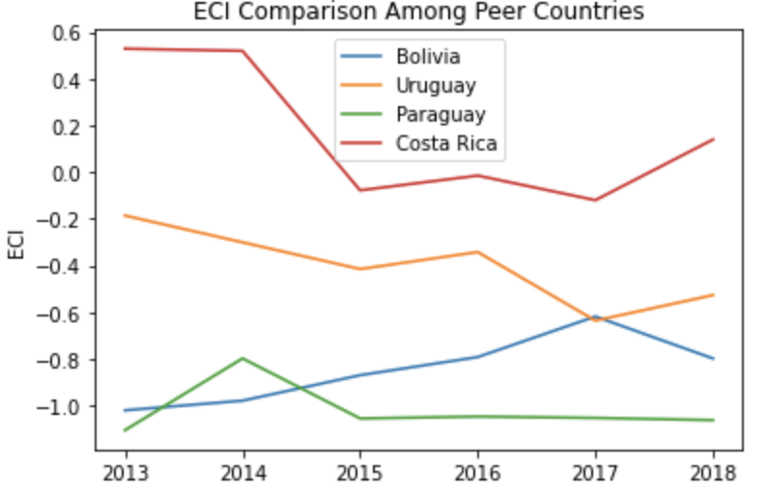
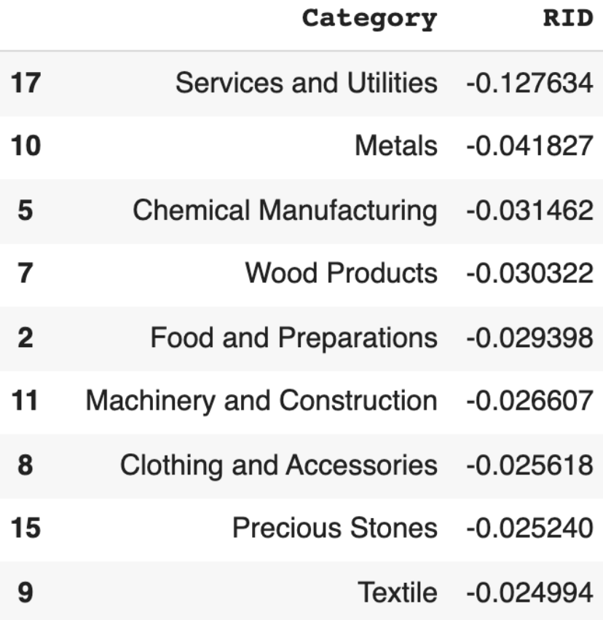
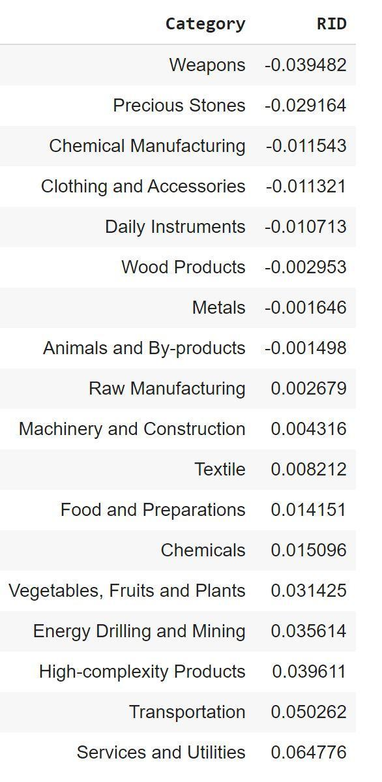
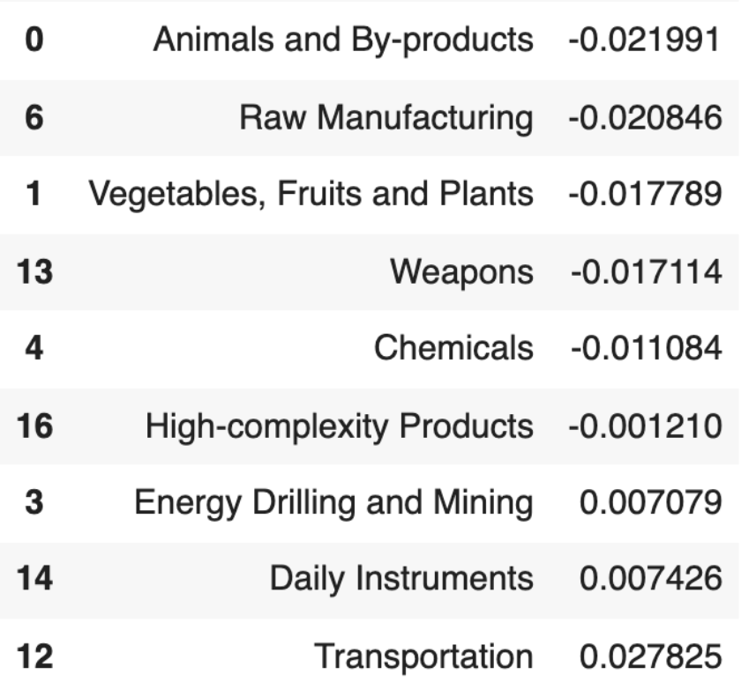
6.40.1 Bolivia
GDP PPP 2013: 65.7 billion
GDP PPP 2018: 89.4 billion
GDP Growth over period: 36.1%
GDP Comparison Among Peer Countries
ECI Comparison Among Peer Countries
Realized Industry Development
Notes:
The country of Bolivia is a developing(developed) country that had a GDP PPP of 40.3B(X) USD in 2018. Representing a high growth rate of 36.3%(X) over 5 years, this GDP growth is very much in line with peer countries of Uruguay, Paraguay and Costa Rica (X), as Bolivia ranks 2nd (X) on its 2018 GDP within this peer set. In terms of ECI, Bolivia had a moderate(X) rate of growth, and remains lower(X) than peer countries of Costa Rica and Uruguay. In regards to its realized development, Bolivia primarily focused on the industries of Services and Utilities and Metals (X).

Slide 36
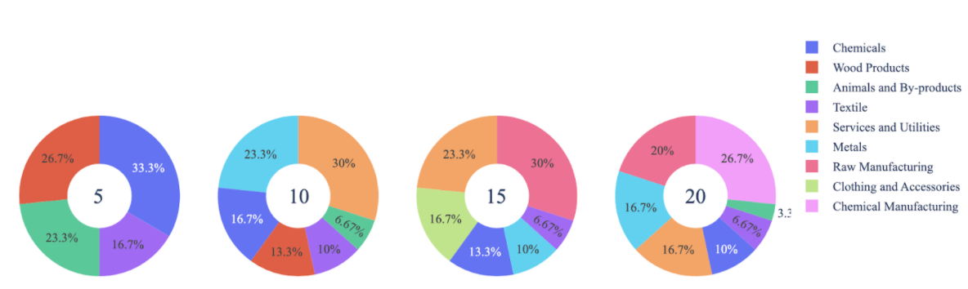
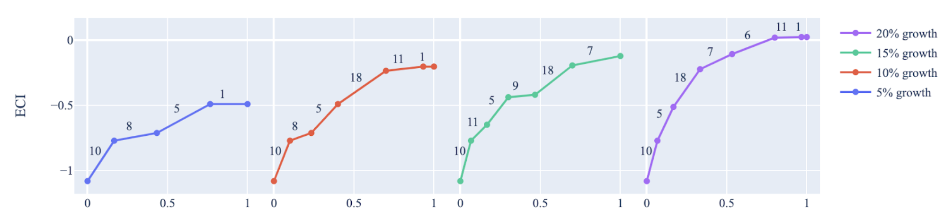
6.40.2 Bolivia - Growth Optimization Results
Industry Optimization Results
Suggested Development Vector
High Complexity Products
Transportation
Machinery and Construction
Daily Instruments
Chemicals
Animal and By-Products
Chemical Manufacturing
Raw Manufacturing
Textile
Metals
Clothing and accessories
Wood Products
Service and Utilities
Vegetables, Fruits and Plants
Food and Preparations
Energy, Drilling and Mining
Weapons
Precious Stones
ECI: -0.831
High Complexity Products must be prioritized for optimal growth!
ECI Increment
Notes:
If we first analyze the suggested development vector for Bolivia, we see that 13 industries offer a positive opportunity gain for investment. This is highly characteristic of developing countries, as their level of economic complexity is often not high. Specifically, the industries of High-complexity Products and Transportation pose highest degree of opportunity gain in ECI, which is in line with many of Bolivia’s developing peers.
If we then turn to the question of budget allocation, we see the following results for Bolivia. Here, we are targeting growth rates of 5, 10, 15 and 20% respectively, and then using a greedy algorithm to determine which industries should bee prioritized. For short term gain (5% growth), it seems that wood products and chemicals should be prioritized. However, for long term, larger growth, a more complex approach may be required, as Bolivia should allocate more resources towards chemical manufacturing and raw manufacturing.

Slide 37
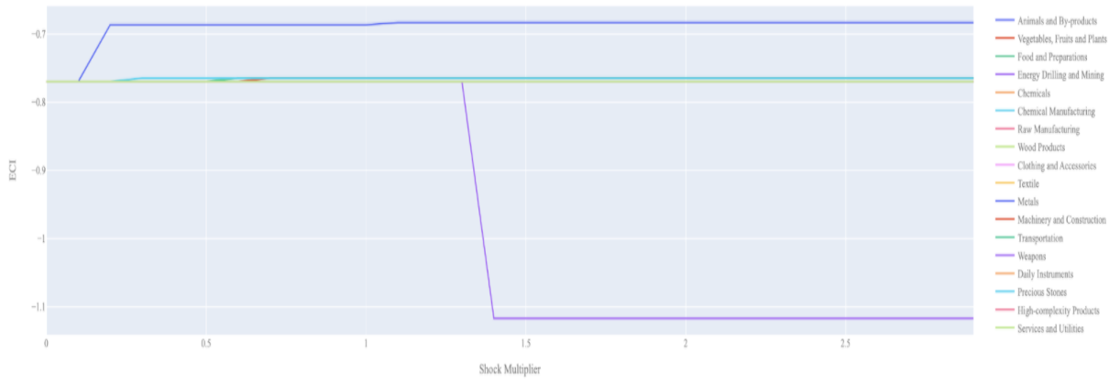
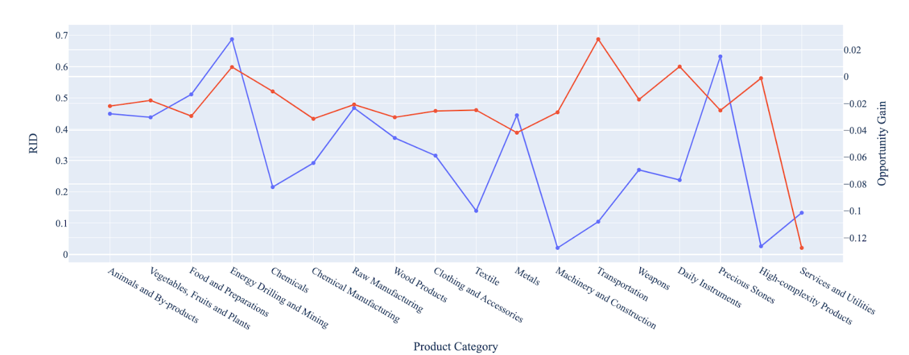
6.40.3 Bolivia - Sensitivity Analysis
Positive Shock
Negative Shock
SOI of Bolivia
The mixed progress during the period, we believe, can be partially explained through analysis of the economic and product complexity structure of Bolivia on the industry group level. The product classification system we adopt allows us to measure the realized industry development for various industry groups and to observe that Bolivia consistently relied on developing the Transportation and High- Complexity Products industries during the period, while its developed counterparts and emerging economies around the globe adopted much more complex and progressive paths.
RID - Red
Opp Gain - Blue
Notes:
Finally, we look to build strategies for nations to adjust after shocks may affect certain industries, and use this to help us better understand the role ECI plays in promoting economic growth.
Above is Bolivia’s 2018 ECI Sensitivity Charts. Firstly in the positive chart, we notice immediately that increases in Metals and Precious Stones lead to an uptrend in ECI. Metals offer the best ECI growth per unit of export increase. All other industries tend to not greatly affect the ECI level making it fairly clear which industry to pursue.
Next we consider Bolivia’s 2018 Negative Shock chart. We see that Bolivia’s ECI is slightly sensitive to drawdowns in Weapons, which suggests that the country should limit investment in the industry. More interestingly, we see that large decreases in Precious Stones and Energy, Mining and Drilling seem to greatly increase the ECI score. These industries are two very important industries for Bolivia’s economy and thus the results that are reflected in the chart may be suggesting that there is another industry that could be just as beneficial for Bolivia that is far in proximity from them.

Slide 38
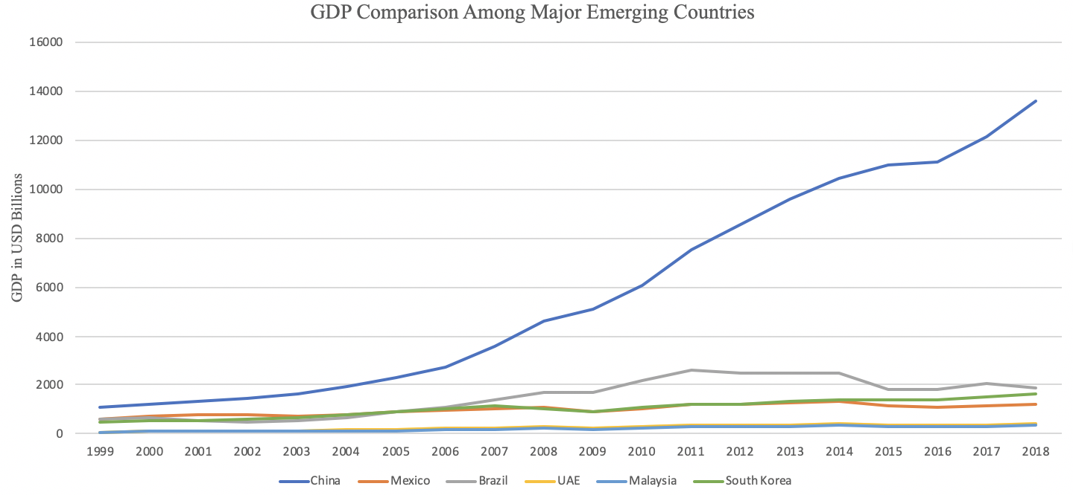
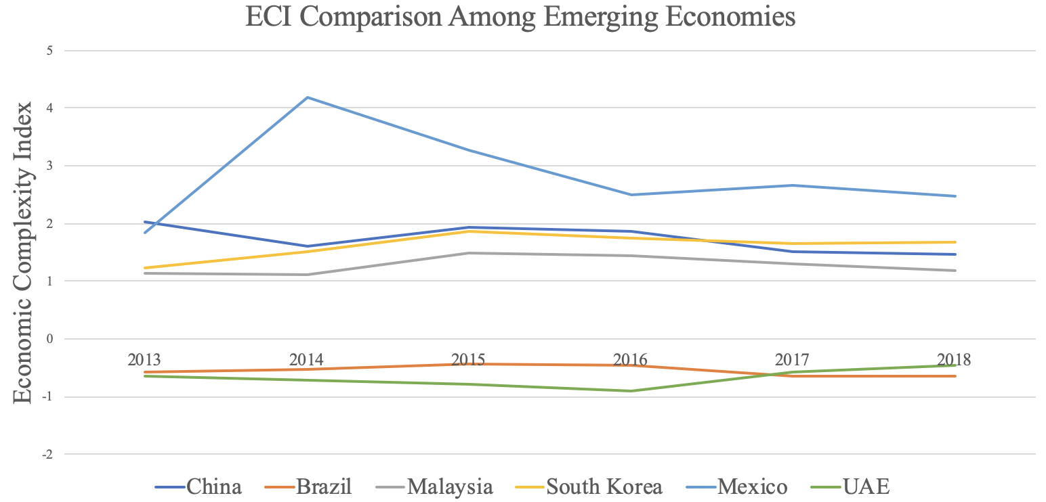
6.1.1 Brazil
GDP PPP 2013: 2.47 trillion
GDP PPP 2018: 1.87 trillion
GDP Growth over period: -24%
GDP Comparison Among Major Emerging Countries
ECI Comparison Among Major Emerging Countries
Realized Industry Development
Notes:
If we take a look at a developing country like Brazil, we see that despite being in line with other developed countries in terms of GDP, Brazil lags considerably in terms of its complexity. This is likely a potential contributing factor towards the steep decline in GDP of 24% over 5 years to 1.87 tr USD

Slide 39
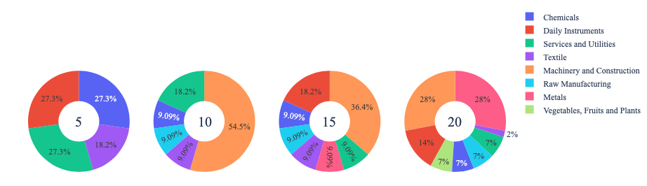
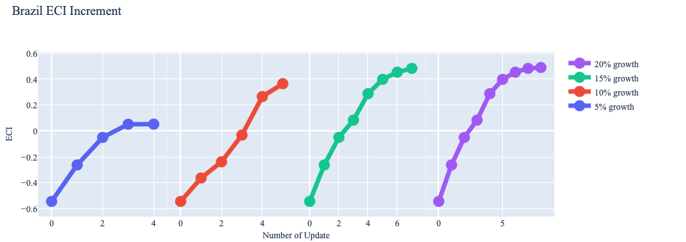
6.1.2 Brazil - Growth Optimization Results
Industry Optimization Results
Suggested Development Vector
Machinery & Construction must be prioritized based on the SDV for optimal growth!
Machinery & Construction
High-complexity Products
Transportation
Precious Stones
Services and Utilities
Weapons
Daily Instruments
Raw Manufacturing
Clothing and Accessories
Chemical Manufacturing
Textiles
Animals and By-products
Vegetables, Fruits and Plants
Food and Preparations
Energy Drilling and Mining
Chemicals
Wood Products
Metals
ECI: -0.544
ECI Increment
* The numbers at the center of the pie charts (5, 10, 15 and 20) represent the percent increase in the budget when determining allocation strategies
Notes:
In regard to how we actually built out the suggested development vector, we employed our greedy strategy over 20 iterations to arrive at an optimal path of development. Specifically, we found that investment in Machinery & Construction, and High-complexity Products would lead to the most optimal growth of complexity.

Slide 40
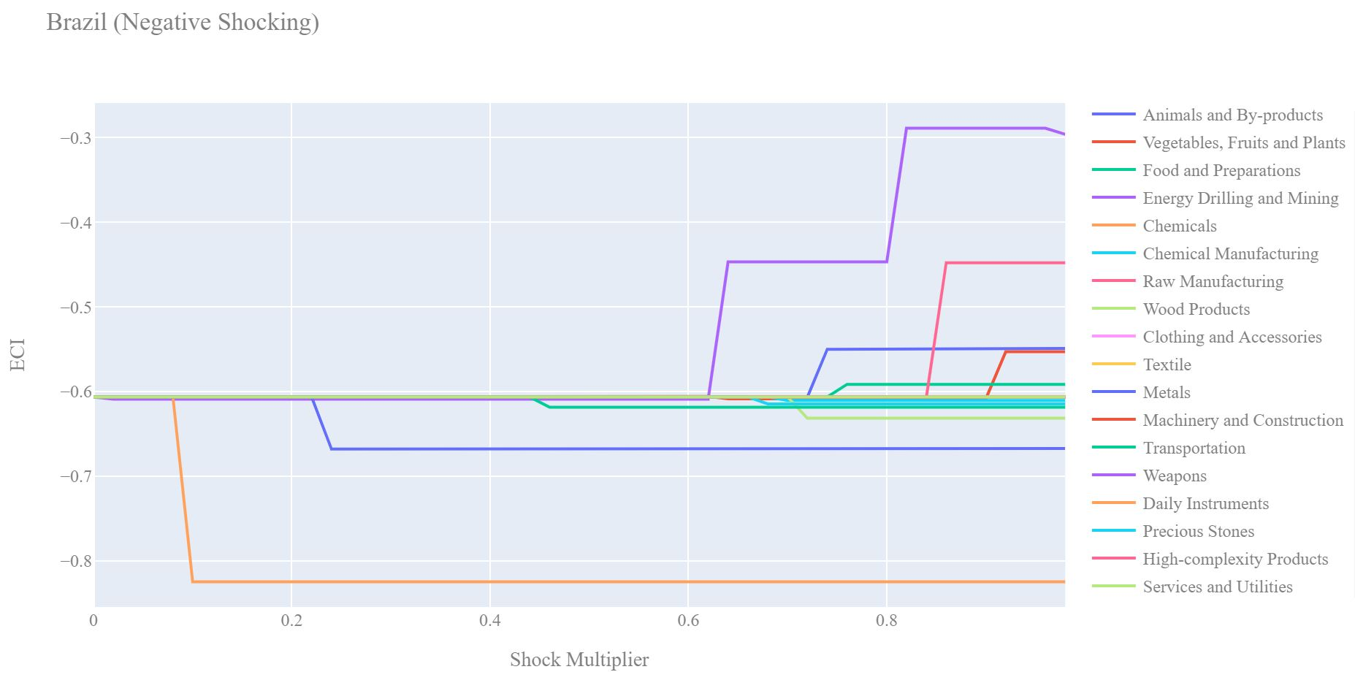
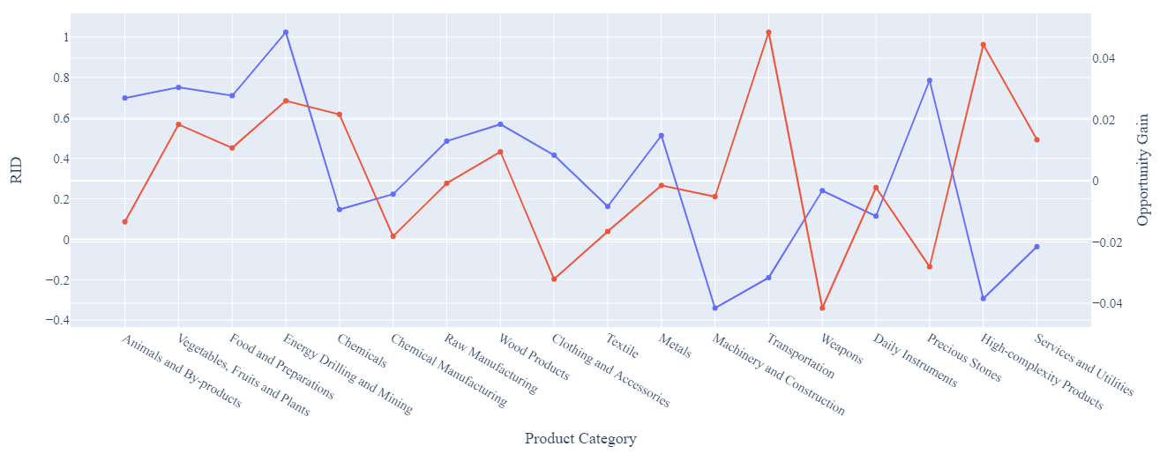
6.1.3 Brazil - Sensitivity Analysis
Positive Shock
Negative Shock
SOI of Brazil
Realized development follows suggested development for the large part, with exceptions in Machinery & Construction and Transportation, both of which need to be better prioritized as per SDV. Thus, Brazil is growing at suboptimal levels
RID - Red
Opp Gain - Blue
Notes:
Based on the sensitivity analysis, we see that industries such as High-Complexity Products and Transportation are highly sensitive to a positive shock, with the Energy Drilling industry being most sensitive to a negative shock. We then looked the SOI and notice that realized development follows suggested development for the large part, with exceptions in Machinery & Construction and Transportation, both of which need to be better prioritized as per SDV. Thus, Brazil is growing at suboptimal levels

Slide 41
6.2.1 China
GDP PPP 2013: 9.57 trillion
GDP PPP 2018: 13.6 trillion
GDP Growth over period: 42.2%
GDP Comparison Among Leading Countries
ECI Comparison Among Leading Countries
Realized Industry Development
Notes:
China is a leading economy that has experienced a 5-year growth rate much higher than counterparts, growing 42.2% since 2013 to a GDP of 13.6tr. Similarly, China’s level of complexity is much higher than peers, which is a potential contributing factor towards the high growth rate.

Slide 42
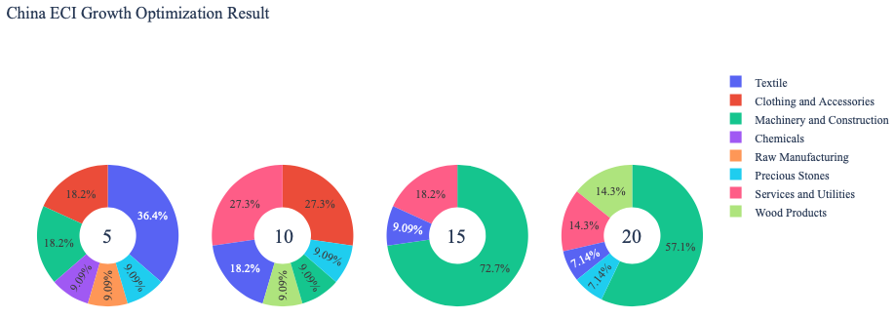
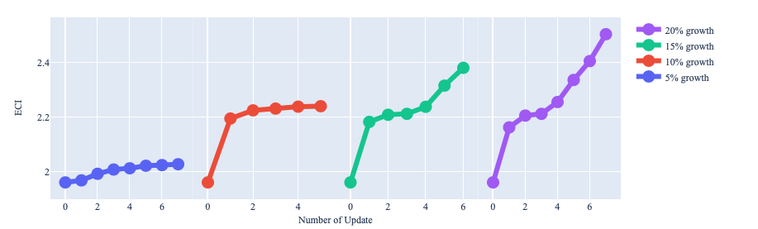
6.2.2 China - Growth Optimization Results
Industry Optimization Results
Suggested Development Vector
Raw Manufacturing must be prioritized based on the SDV for optimal growth!
Raw Manufacturing
Clothing and Accessories
Textiles
Machinery & Construction
Transportation
Weapons
Daily Instruments
High-complexity Products
Precious Stones
Services and Utilities
Chemicals
Energy Drilling and Mining
Chemical Manufacturing
Wood Products
Animals and By-products
Vegetables, Fruits and Plants
Metals
Food and Preparations
ECI: 1.96086598
ECI Increment
* The numbers at the center of the pie charts (5, 10, 15 and 20) represent the percent increase in the budget when determining allocation strategies

Slide 43
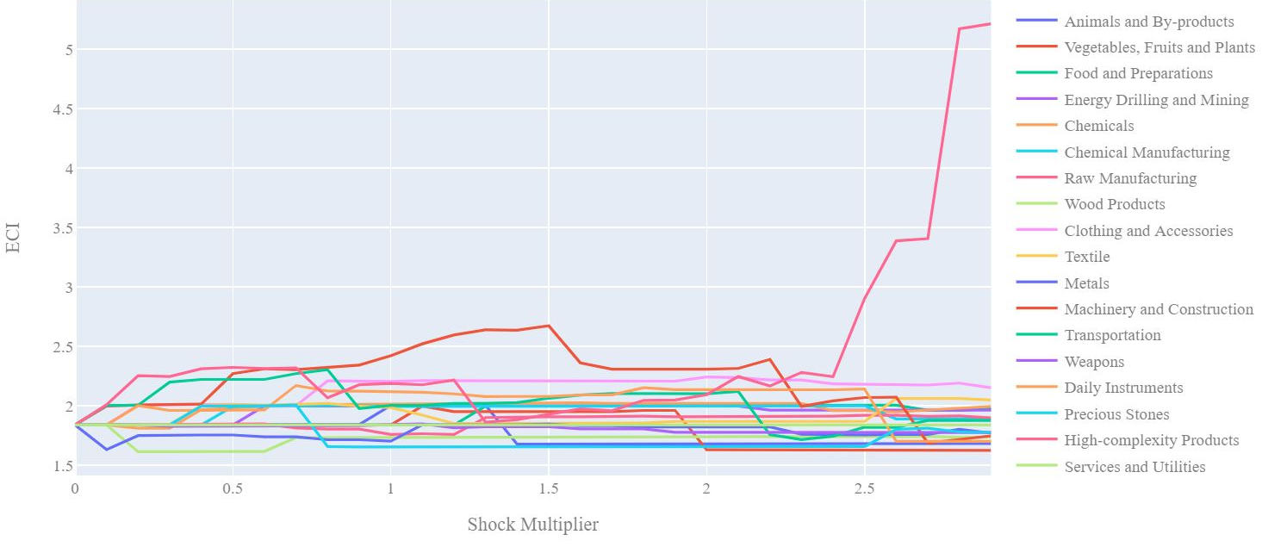
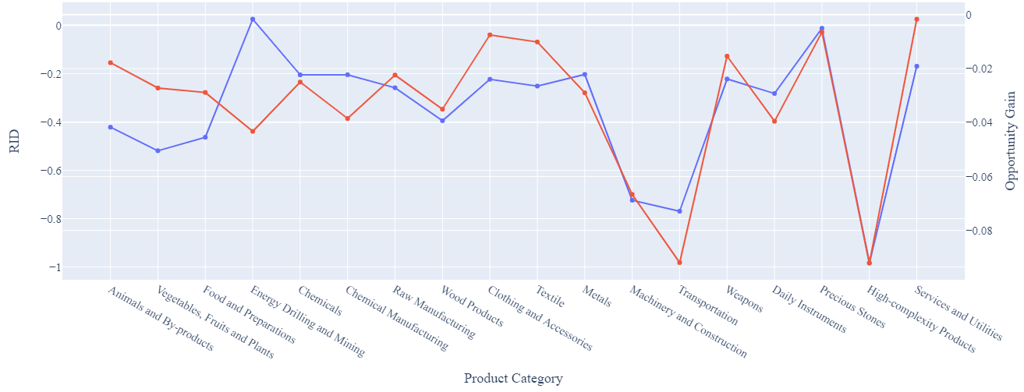
6.2.3 China - Sensitivity Analysis
Positive Shock
Negative Shock
SOI of China
Realized development follows suggested development almost perfectly, which explains at least partially, China’s amazing economic progress
RID - Red
Opp Gain - Blue

Slide 44
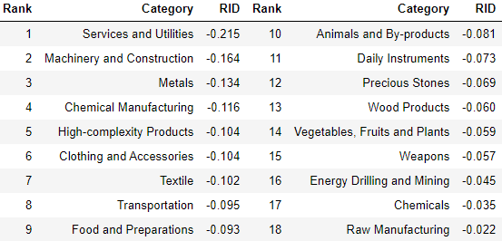
6.3.1 Colombia
GDP PPP 2013: 381 million
GDP PPP 2018: 331 million
GDP Growth over period: -13%
GDP Comparison Among Major Emerging Countries
ECI Comparison Among Major Emerging Countries
Realized Industry Development

Slide 45
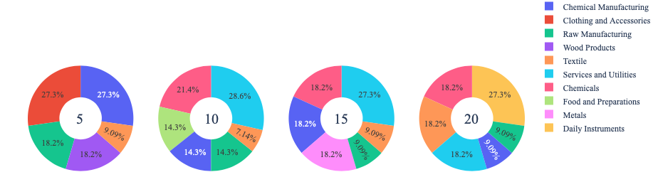
6.3.2 Colombia - Growth Optimization Results
Industry Optimization Results
Suggested Development Vector
High-Complexity Products must be prioritized based on the SDV for optimal growth!
High-complexity Products
Machinery and Construction
Transportation
Services and Utilities
Daily Instruments
Chemicals
Weapons
Chemical Manufacturing
Textile
Raw Manufacturing
Metals
Food and Preparations
Animals and By-products
Wood Products
Clothing and Accessories
Vegetables, Fruits and Plants
Energy Drilling and Mining
Precious Stones
ECI: -1.752771623
ECI Increment
* The numbers at the center of the pie charts (5, 10, 15 and 20) represent the percent increase in the budget when determining allocation strategies

Slide 46
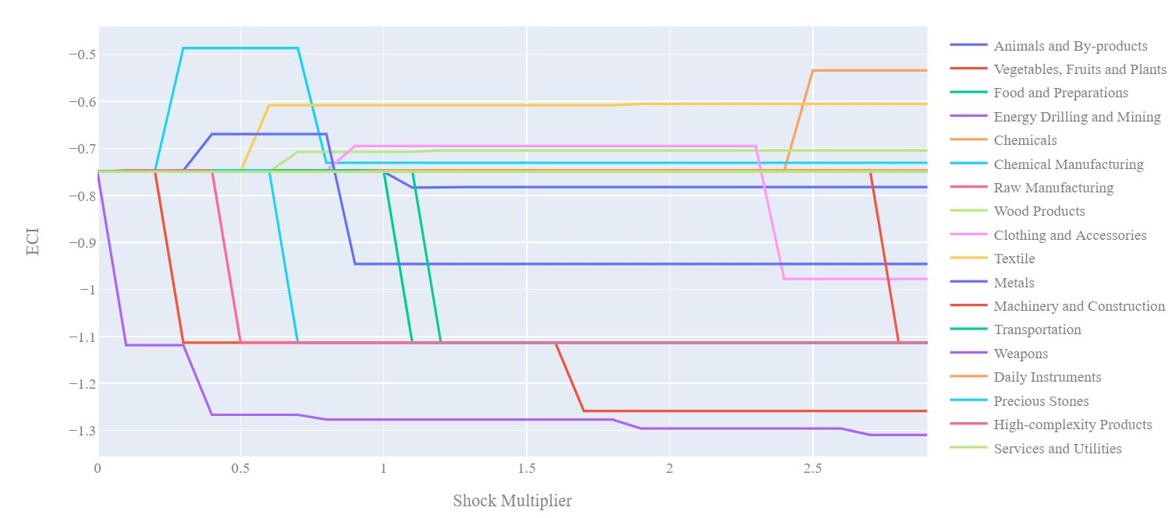
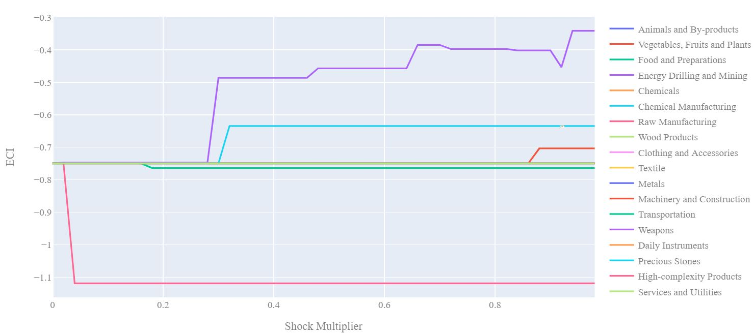
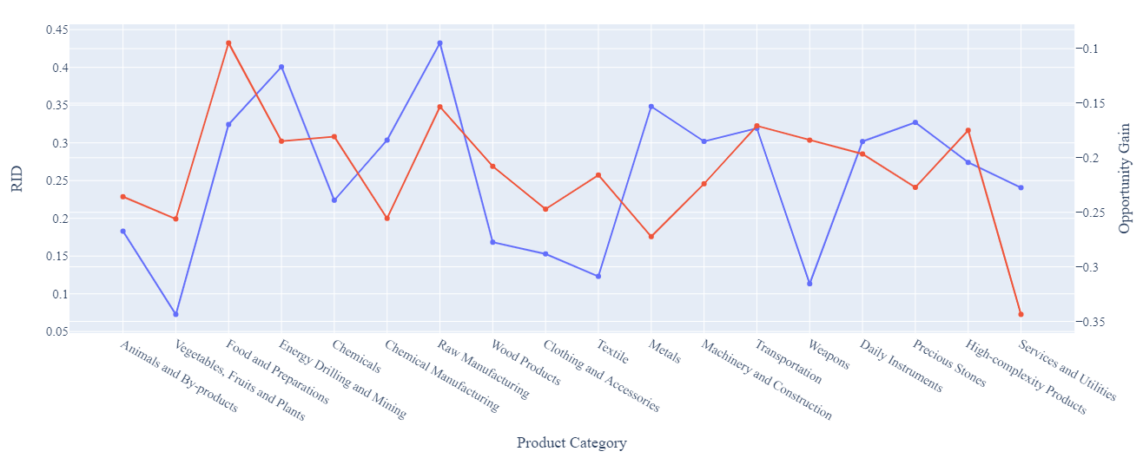
6.3.3 Colombia - Sensitivity Analysis
Positive Shock
Negative Shock
SOI of Colombia
Realized development follows suggested development for the large part, with exceptions in Weapons and Services & Utilities, both of which need to be better prioritized as per SDV. Thus, Colombia is growing at suboptimal levels
RID - Red
Opp Gain - Blue

Slide 47
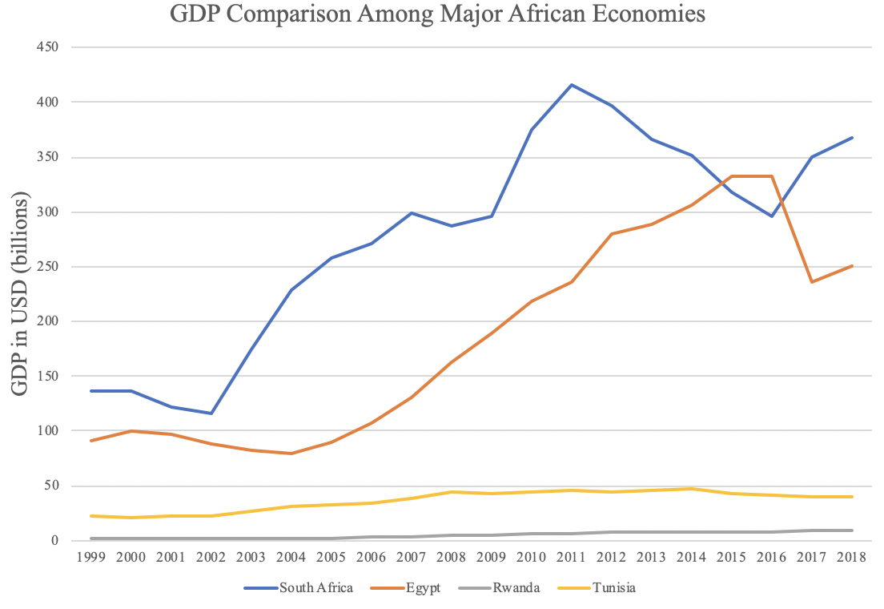
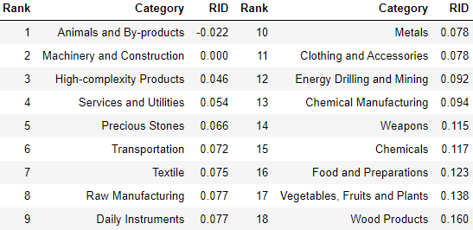
6.4.1 Egypt
GDP PPP 2013: 285 million
GDP PPP 2018: 250 million
GDP Growth over period: -13%
GDP Comparison Among Major African Countries
ECI Comparison Among Major African Countries
Realized Industry Development

Slide 48
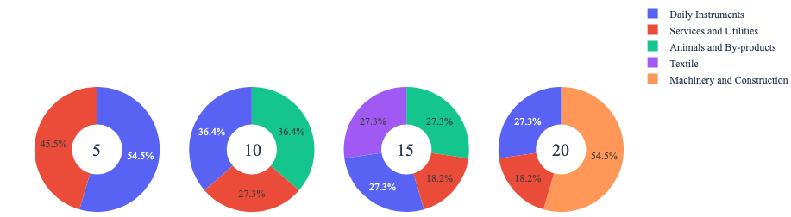
6.4.2 Egypt - Growth Optimization Results
Industry Optimization Results
Suggested Development Vector
Weapons must be prioritized based on the SDV for optimal growth!
Weapons
Daily Instruments
Services and Utilities
Machinery and Construction
High-complexity Products
Transportation
Animals and By-products
Vegetables, Fruits and Plants
Food and Preparations
Energy Drilling and Mining
Chemicals
Chemical Manufacturing
Raw Manufacturing
Wood Products
Clothing and Accessories
Textile
Metals
Precious Stones
ECI: -0.264921964
ECI Increment
* The numbers at the center of the pie charts (5, 10, 15 and 20) represent the percent increase in the budget when determining allocation strategies

Slide 49
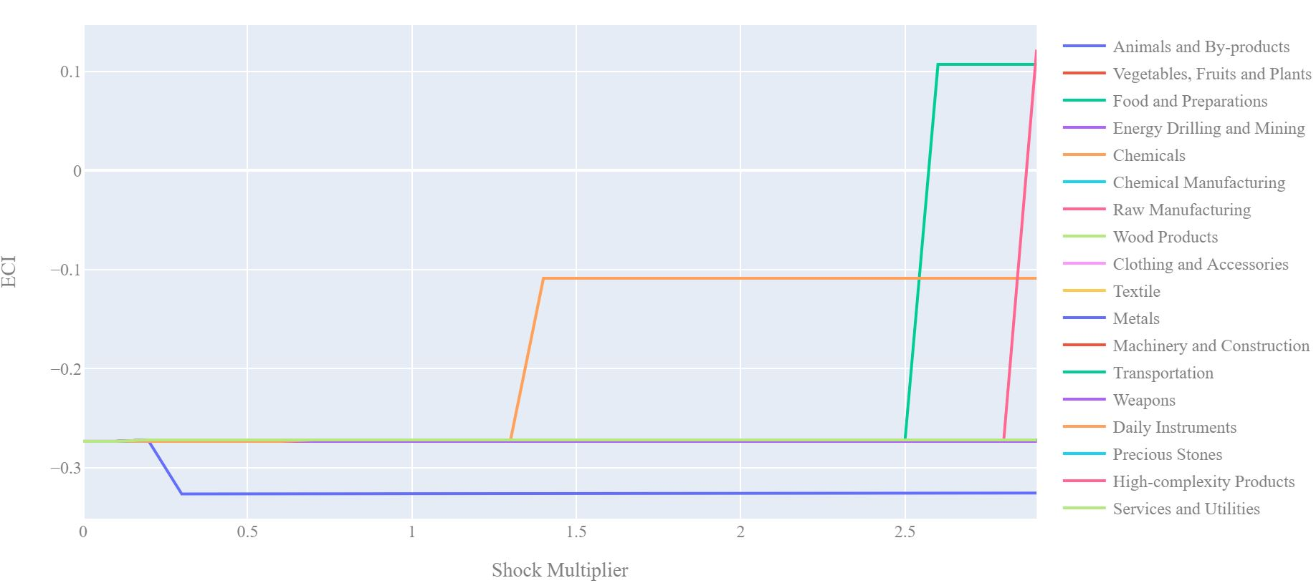
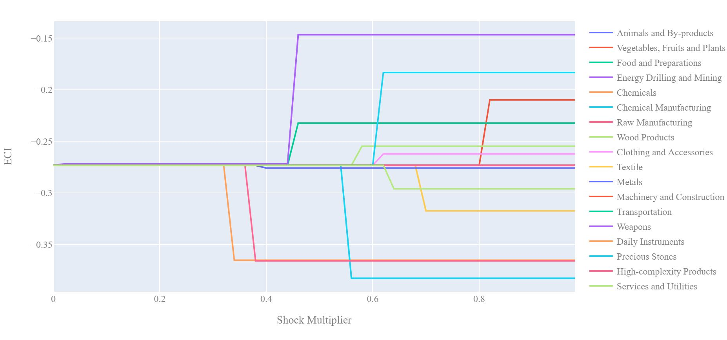
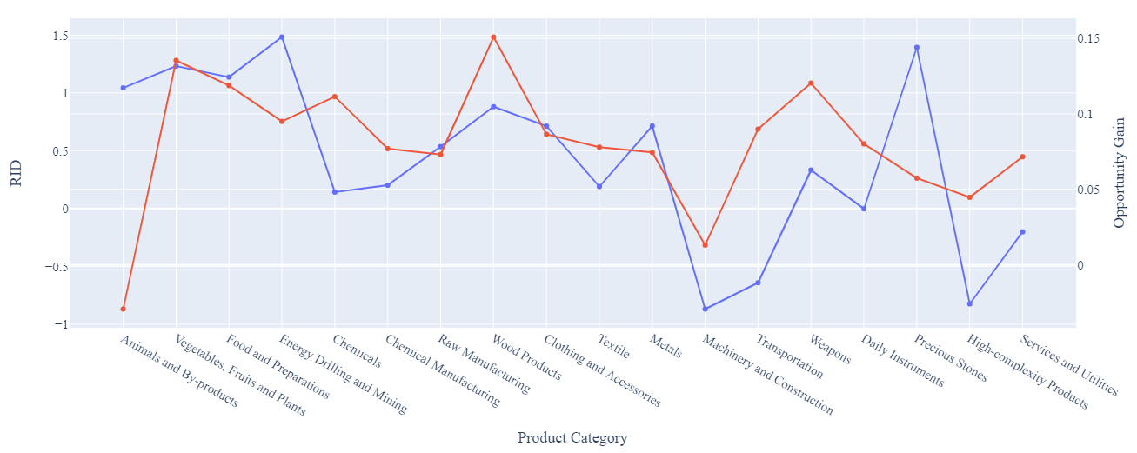
6.4.3 Egypt - Sensitivity Analysis
Positive Shock
Negative Shock
SOI of Egypt
Realized development follows suggested development for the large part, with exceptions in Transportation and Precious Metal both of which need to be better prioritized as per SDV. Thus, Egypt is growing at suboptimal levels
RID - Red
Opp Gain - Blue

Slide 50
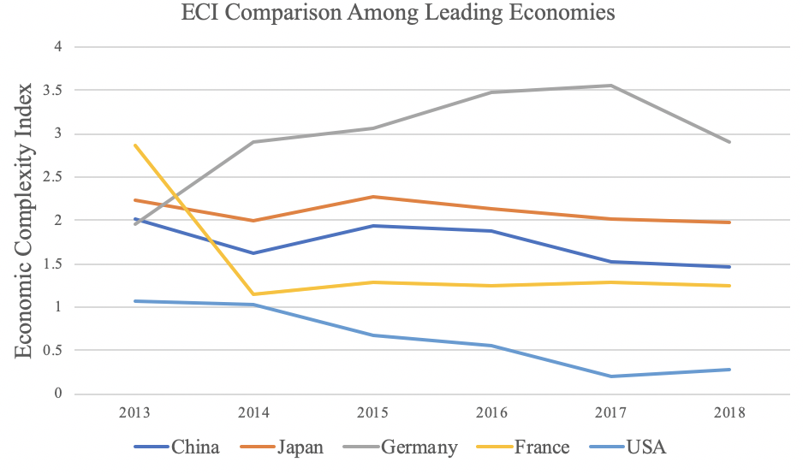
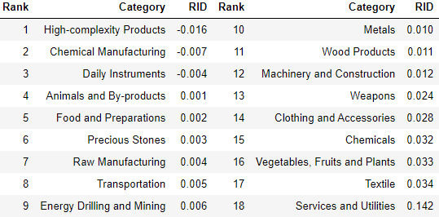
6.5.1 France
GDP PPP 2013: 2.8 trillion
GDP PPP 2018: 2.77 trillion
GDP Growth over period: -1.2%
GDP Comparison Among Major Leading Countries
ECI Comparison Among Major Leading Countries
Realized Industry Development

Slide 51
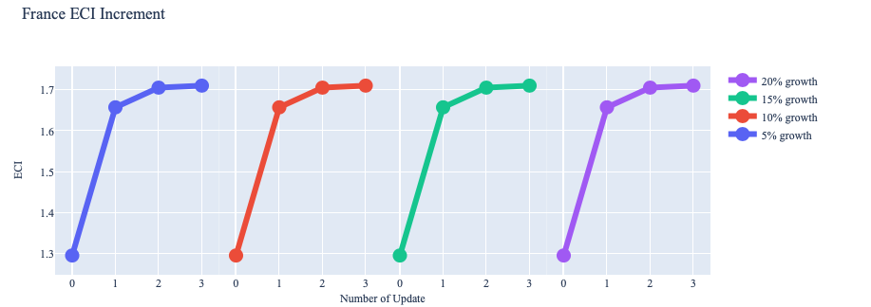
6.5.2 France - Growth Optimization Results
Industry Optimization Results
Suggested Development Vector
Services and Utilities must be prioritized based on the SDV for optimal growth!
Services and Utilities
Energy Drilling and Mining
Animals and By-products
Food and Preparations
Chemical Manufacturing
Raw Manufacturing
Transportation
Weapons
High-complexity Products
Vegetables, Fruits and Plants
Precious Stones
Wood Products
Chemicals
Textile
Clothing and Accessories
Daily Instruments
Metals
Machinery and Construction
ECI: 1.294691459
ECI Increment
* The numbers at the center of the pie charts (5, 10, 15 and 20) represent the percent increase in the budget when determining allocation strategies

Slide 52
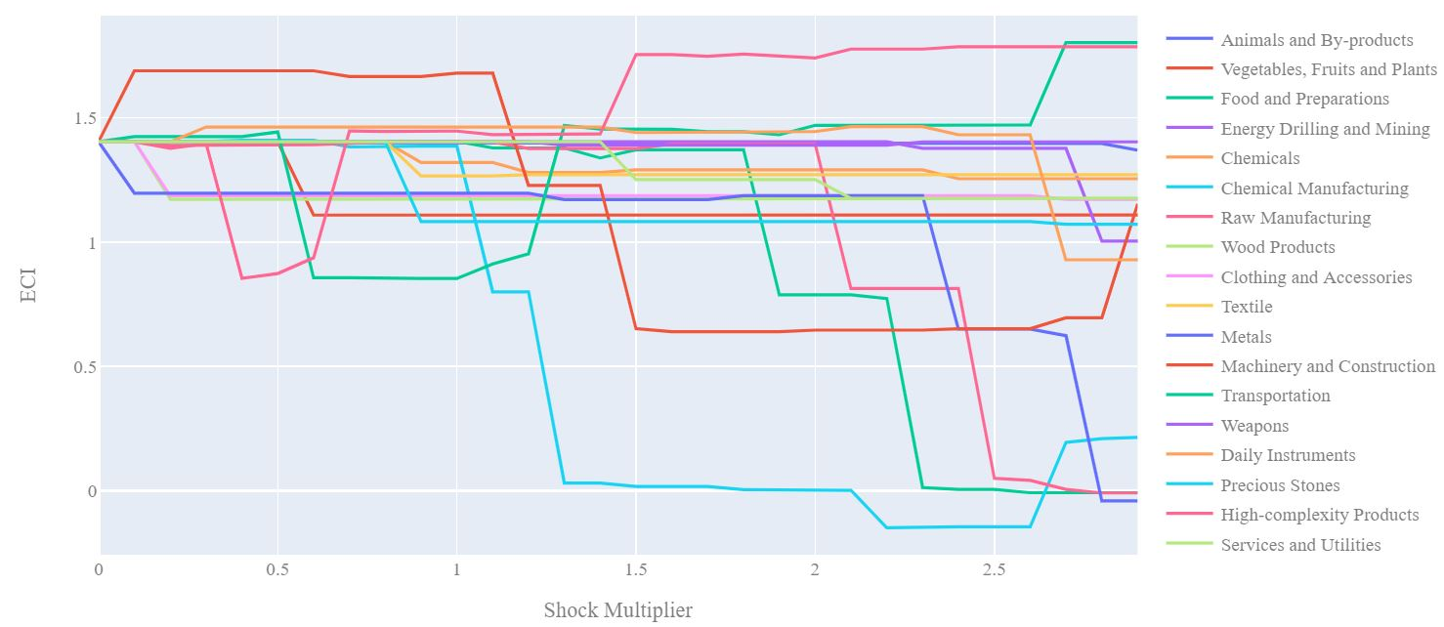

6.5.3 France - Sensitivity Analysis
Positive Shock
Negative Shock
SOI of France
RID - Red
Opp Gain - Blue

Slide 53

6.6.1 Germany
GDP PPP 2013: 3.7 trillion
GDP PPP 2018: 3.9 trillion
GDP Growth over period: 5.8%
GDP Comparison Among Major Leading Countries
ECI Comparison Among Major Leading Countries
Realized Industry Development

Slide 54


6.6.2 Germany - Growth Optimization Results
Industry Optimization Results
Suggested Development Vector
Chemical Manufacturing must be prioritized based on the SDV for optimal growth!
Chemical Manufacturing
Wood Products
Metals
Machinery and Construction
Transportation
Weapons
High-complexity Products
Services and Utilities
Energy Drilling and Mining
Precious STones
Textile
Clothing and Accessories
Chemicals
Animals and By-products
Vegetables, Fruits and Plants
Food and Preparations
Daily Instruments
Raw Manufacturing
ECI: 1.937171566
ECI Increment
* The numbers at the center of the pie charts (5, 10, 15 and 20) represent the percent increase in the budget when determining allocation strategies

Slide 55



6.6.3 Germany - Sensitivity Analysis
Positive Shock
Negative Shock
SOI of Germany
Realized development follows suggested development for the large part, with exceptions in Energy Drilling & Mining and Wood Products both of which need to be better prioritized as per SDV. Thus, Germany is growing at suboptimal levels
RID - Red
Opp Gain - Blue

Slide 56


6.7.1 Greece
GDP PPP 2013: 239 million
GDP PPP 2018: 218 million
GDP Growth over period: -9%
GDP Comparison Among Major European Countries
ECI Comparison Among Major Leading Countries
Realized Industry Development

Slide 57


6.7.2 Greece - Growth Optimization Results
Industry Optimization Results
Suggested Development Vector
Precious Stones must be prioritized based on the SDV for optimal growth!
Precious Stones
Weapons
Clothing and Accessories
Machinery and Construction
Services and Utilities
High-complexity Products
Daily Instruments
Transportation
Chemicals
Animals and By-products
Vegetables, Fruits and Plants
Food and Preparations
Energy Drilling and Mining
Chemical Manufacturing
Raw Manufacturing
Wood Products
Textile
Metals
ECI: -0.232930358
ECI Increment
* The numbers at the center of the pie charts (5, 10, 15 and 20) represent the percent increase in the budget when determining allocation strategies

Slide 58


6.7.3 Greece - Sensitivity Analysis
Positive Shock
Negative Shock
SOI of Greece
Realized development follows suggested development for the large part, with exceptions in Transportation and Chemical Manufacturing both of which need to be better prioritized as per SDV. Thus, Greece is growing at suboptimal levels
RID - Red
Opp Gain - Blue

Slide 59


6.8.1 Indonesia
GDP PPP 2013: 912 million
GDP PPP 2018: 1042 million
GDP Growth over period: 14.2%
GDP Comparison Among Major Asian Economies
ECI Comparison Among Major Asian Economies
Realized Industry Development

Slide 60

6.8.2 Indonesia - Growth Optimization Results
Industry Optimization Results
Suggested Development Vector
Services and Utilities must be prioritized based on the SDV for optimal growth!
Precious Stones
Machinery and Construction
Food and Preparations
High-complexity Products
Services and Utilities
Metals
Daily Instruments
Transportation
Chemicals
Chemical Manufacturing
Animals and By-products
Vegetables, Fruits and Plants
Energy Drilling and Mining
Raw Manufacturing
Wood Products
Clothing and Accessories
Textile
Weapons
ECI: -0.298641635
ECI Increment
* The numbers at the center of the pie charts (5, 10, 15 and 20) represent the percent increase in the budget when determining allocation strategies

Slide 61

6.8.3 Indonesia - Sensitivity Analysis
Positive Shock
Negative Shock
SOI of Indonesia
Realized development follows suggested development for the large part, with exceptions in Transportation and High-complexity Products both of which need to be better prioritized as per SDV. Thus, Indonesia is growing at suboptimal levels.
RID - Red
Opp Gain - Blue

Slide 62

6.9.1 Italy
GDP PPP 2013: 2.1 trillion
GDP PPP 2018: 2.08 trillion
GDP Growth over period: -2.7%
GDP Comparison Among Major European Countries
ECI Comparison Among Major European Countries
Realized Industry Development

Slide 63


6.9.2 Italy - Growth Optimization Results
Industry Optimization Results
Suggested Development Vector
Energy Drilling and Mining must be prioritized based on the SDV for optimal growth!
Energy Drilling and Mining
Precious Stones
Vegetables, Fruits and Plants
Animals and By-products
Food and Preparations
Chemical Manufacturing
Raw Manufacturing
Wood Products
Clothing and Accessories
Textile
Metals
Machinery and Construction
Daily Instruments
High-complexity Products
Weapons
Chemicals
Services and Utilities
Transportation
ECI: 1.79705915
ECI Increment
* The numbers at the center of the pie charts (5, 10, 15 and 20) represent the percent increase in the budget when determining allocation strategies

Slide 64



6.9.3 Italy - Sensitivity Analysis
Positive Shock
Negative Shock
SOI of Italy
Realized development follows suggested development for the large part, with exceptions in Energy Drilling & Mining and Precious Stones both of which need to be better prioritized as per SDV. Thus, Italy is growing at suboptimal levels
RID - Red
Opp Gain - Blue

Slide 65

6.10.1 Japan
GDP PPP 2013: 5.1 trillion
GDP PPP 2018: 4.9 trillion
GDP Growth over period: -3.6%
GDP Comparison Among Major Leading Countries
ECI Comparison Among Major Leading Countries
Realized Industry Development

Slide 66

6.10.2 Japan - Growth Optimization Results
Industry Optimization Results
Suggested Development Vector
Chemicals must be prioritized based on the SDV for optimal growth!
Chemicals
Metals
Machinery and Construction
Transportation
Weapons
Daily Instruments
High-complexity Products
Services and Utilities
Precious Stones
Energy Drilling and Mining
Textile
Clothing and Accessories
Chemical Manufacturing
Animals and By-products
Wood Products
Vegetables, Fruits and Plants
Food and Preparations
Raw Manufacturing
ECI: 2.154947
ECI Increment
* The numbers at the center of the pie charts (5, 10, 15 and 20) represent the percent increase in the budget when determining allocation strategies

Slide 67


6.10.3 Japan - Sensitivity Analysis
Positive Shock
Negative Shock
SOI of Japan
Realized development follows suggested development for the large part, with exceptions in Machinery & Construction and Energy Drilling & Mining both of which need to be better prioritized as per SDV. Thus, Japan is growing at suboptimal levels
RID - Red
Opp Gain - Blue

Slide 68

6.11.1 Malaysia
GDP PPP 2013: 323 millio
GDP PPP 2018: 358 million
GDP Growth over period: 10.9%
GDP Comparison Among Emerging Countries
ECI Comparison Among Emerging Countries
Realized Industry Development

Slide 69


6.11.2 Malaysia - Growth Optimization Results
Industry Optimization Results
Suggested Development Vector
Services and Utilities must be prioritized based on the SDV for optimal growth!
Services and Utilities
Machinery & Construction
Vegetables, Fruits and Plants
Energy Drilling and Mining
Raw Manufacturing
Transportation
High-complexity Products
Chemicals
Weapons
Chemical Manufacturing
Daily Instruments
Animals and By-products
Food and Preparations
Precious Stones
Textiles
Wood Products
Metals
Clothing and Accessories
ECI: 1.090379108
ECI Increment
* The numbers at the center of the pie charts (5, 10, 15 and 20) represent the percent increase in the budget when determining allocation strategies

Slide 70



6.1.3 Malaysia - Sensitivity Analysis
Positive Shock
Negative Shock
SOI of Malaysia
Realized development follows suggested development for the large part, with the exception in Weapons which need to be better prioritized as per SDV. Thus, Malaysia is growing at suboptimal levels.
RID - Red
Opp Gain - Blue

Slide 71

6.12.1 Mexico
GDP PPP 2013: 1.27 trillion
GDP PPP 2018: 1.22 trillion
GDP Growth over period: -4%
GDP Comparison Among Emerging Countries
ECI Comparison Among Emerging Countries
Realized Industry Development

Slide 72
6.12.2 Mexico - Growth Optimization Results
Industry Optimization Results
Suggested Development Vector
Vegetables, Fruits and Plants must be prioritized based on the SDV for optimal growth!
Vegetables, Fruits and Plants
Machinery & Construction
Transportation
High-complexity Products
Services and Utilities
Chemicals
Textiles
Weapons
Daily Instruments
Chemical Manufacturing
Clothing and Accessories
Raw Manufacturing
Food and Preparations
Animals and By-products
Metals
Wood Products
Precious Stones
Energy Drilling and Mining
ECI: 2.753793255
ECI Increment
* The numbers at the center of the pie charts (5, 10, 15 and 20) represent the percent increase in the budget when determining allocation strategies

Slide 73

6.12.3 Mexico - Sensitivity Analysis
Positive Shock
Negative Shock
SOI of Malaysia
Realized development follows suggested development for the large part, with exceptions in Animals & By-products and Vegetables, Fruits & Plants both of which need to be better prioritized as per SDV. Thus, Malaysia is growing at suboptimal levels.
RID - Red
Opp Gain - Blue

Slide 74


6.13.1 Morocco
GDP PPP 2013: 106 million
GDP PPP 2018: 117 million
GDP Growth over period: 10.4%
GDP Comparison Among Major African Countries
ECI Comparison Among Major African Countries
Realized Industry Development

Slide 75


6.13.2 Morocco - Growth Optimization Results
Industry Optimization Results
Suggested Development Vector
Machinery & Construction must be prioritized based on the SDV for optimal growth!
Machinery & Construction
Services and Utilities
Weapons
Daily Instruments
Energy Drilling and Mining
Precious Stones
Textiles
Food and Preparations
Animals and By-products
Vegetables, Fruits and Plants
Chemicals
Chemical Manufacturing
Clothing and Accessories
Transportation
Wood Products
Raw Manufacturing
High-complexity Products
Metals
ECI: 0.639107694
ECI Increment
ECI Increment
* The numbers at the center of the pie charts (5, 10, 15 and 20) represent the percent increase in the budget when determining allocation strategies

Slide 76



6.13.3 Morocco - Sensitivity Analysis
Positive Shock
Negative Shock
SOI of Morocco
Realized development follows suggested development for the large part, with the exception of Services & Utilities which need to be better prioritized as per SDV. Thus, Morocco is growing at suboptimal levels.
RID - Red
Opp Gain - Blue

Slide 77

6.14.1 Poland
GDP PPP 2013: 524 million
GDP PPP 2018: 585 million
GDP Growth over period: 11.7%
GDP Comparison Among Major European Countries
ECI Comparison Among Major European Countries
Realized Industry Development

Slide 78


6.14.2 Poland - Growth Optimization Results
Industry Optimization Results
Suggested Development Vector
Chemical Manufacturing must be prioritized based on the SDV for optimal growth!
Energy Drilling and Mining
Precious Stones
Clothing and Accessories
Animals and By-products
Vegetables, Fruits and Plants
Food and Preparations
Raw Manufacturing
Wood Products
Metals
Machinery & Construction
Transportation
Daily Instruments
High-complexity Products
Weapons
Textiles
Chemicals
Chemical Manufacturing
Services and Utilities
ECI: 1.142926
ECI Increment
* The numbers at the center of the pie charts (5, 10, 15 and 20) represent the percent increase in the budget when determining allocation strategies

Slide 79



6.14.3 Poland - Sensitivity Analysis
Positive Shock
Negative Shock
SOI of Poland
Realized development follows suggested development for the large part, with exceptions in Machinery & Construction and Transportation, both of which need to be better prioritized as per SDV. Thus, Poland is growing at suboptimal levels.
RID - Red
Opp Gain - Blue

Slide 80

6.15.1 Portugal
GDP PPP 2013: 226 million
GDP PPP 2018: 240 million
GDP Growth over period: 6%
GDP Comparison Among Major Emerging Countries
ECI Comparison Among Major Emerging Countries
Realized Industry Development

Slide 81


6.15.2 Portugal - Growth Optimization Results
Industry Optimization Results
Suggested Development Vector
Precious Stones must be prioritized based on the SDV for optimal growth!
Energy Drilling and Mining
Machinery & Construction
Precious Stones
High-complexity Products
Services and Utilities
Weapons
Transportation
Daily Instruments
Chemical Manufacturing
Chemicals
Animals and By-products
Vegetables , Fruits, and Plants
Food and Preparations
Raw Manufacturing
Wood Products
Clothing and Accessories
Textile
Metals
ECI: -0.157783672
ECI Increment
ECI Increment
* The numbers at the center of the pie charts (5, 10, 15 and 20) represent the percent increase in the budget when determining allocation strategies

Slide 82


6.15.3 Portugal - Sensitivity Analysis
Positive Shock
Negative Shock
SOI of Portugal
Realized development follows suggested development for the large part, with exceptions in industry groups such as Services & Utilities, which need to be better prioritized as per SDV. Thus, Portugal is growing at suboptimal levels
RID - Red
Opp Gain - Blue

Slide 83

6.16.1 Saudi Arabia
GDP PPP 2013: 746 million
GDP PPP 2018: 786 million
GDP Growth over period: 5%
GDP Comparison Among Major Emerging Countries
ECI Comparison Among Major Emerging Countries
Realized Industry Development

Slide 84

6.16.2 Saudi Arabia - Growth Optimization Results
Industry Optimization Results
Suggested Development Vector
Machinery & Construction must be prioritized based on the SDV for optimal growth!
Machinery & Construction
High-complexity Products
Transportation
Services and Utilities
Daily Instruments
Weapons
Chemical Manufacturing
Textile
Energy Drilling and Mining
Chemicals
Raw Manufacturing
Metals
Wood Products
Animals and By-products
Clothing and Accessories
Precious Stones
Vegetables , Fruits, and Plants
Food and Preparations
ECI: -0.114986575
ECI Increment
ECI Increment
* The numbers at the center of the pie charts (5, 10, 15 and 20) represent the percent increase in the budget when determining allocation strategies

Slide 85


6.16.3 Saudi Arabia - Sensitivity Analysis
Positive Shock
Negative Shock
SOI of Saudi Arabia
Realized development significantly diverges from suggested development, investing little in most industries with the exception of Services & Utilities. Although it is growing at superoptimal levels, its growth may not be sustainable in the long run.
RID - Red
Opp Gain - Blue

Slide 86
6.17.1 Singapore
GDP PPP 2013: 307 million
GDP PPP 2018: 364 million
GDP Growth over period:18%
GDP Comparison Among Major Emerging Countries
ECI Comparison Among Major Emerging Countries
Realized Industry Development

Slide 87


6.17.2 Singapore - Growth Optimization Results
Industry Optimization Results
Suggested Development Vector
Chemicals must be prioritized based on the SDV for optimal growth!
Chemicals
Transportation
High-complexity Products
Services and Utilities
Machinery & Construction
Daily Instruments
Weapons
Textile
Chemical Manufacturing
Raw Manufacturing
Clothing and Accessories
Metals
Wood Products
Precious stones
Animals and By-products
Food and Preparations
Energy Drilling and Mining
Vegetables , Fruits, and Plants
ECI: 2.751108815
ECI Increment
ECI Increment
* The numbers at the center of the pie charts (5, 10, 15 and 20) represent the percent increase in the budget when determining allocation strategies

Slide 88


6.17.3 Singapore - Sensitivity Analysis
Positive Shock
Negative Shock
SOI of Singapore
Realized development diverges considerably from suggested development, investing heavily in Transportation while it should have prioritized industry groups such as Machinery and Construction,
as per SDV. Thus, Singapore is growing at suboptimal levels.
RID - Red
Opp Gain - Blue

Slide 89

6.18.1 South Africa
GDP PPP 2013: 366 million
GDP PPP 2018: 368 million
GDP Growth over period: 0.4%
GDP Comparison Among Major Emerging Countries
ECI Comparison Among Major Emerging Countries
Realized Industry Development

Slide 90

6.18.2 South Africa - Growth Optimization Results
Industry Optimization Results
Suggested Development Vector
High-complexity Products must be prioritized based on the SDV for optimal growth!
High-complexity Products
Machinery & Construction
Animals and By-products
Transportation
Services and Utilities
Daily Instruments
Clothing and Accessories
Chemicals
Chemical Manufacturing
Raw Manufacturing
Textile
Vegetables , Fruits, and Plants
Food and Preparations
Energy Drilling and Mining
Wood Products
Metals
Weapons
Precious stones
ECI: -0.80405844
ECI Increment
ECI Increment
* The numbers at the center of the pie charts (5, 10, 15 and 20) represent the percent increase in the budget when determining allocation strategies

Slide 91



6.18.3 South Africa - Sensitivity Analysis
Positive Shock
Negative Shock
SOI of South Africa
Realized development somewhat aligns with suggested development. Its slow economic progress can only be slightly explained by a mismatched development strategy, as there are many other factors, such as political instability, that the ECI model does not account for.
RID - Red
Opp Gain - Blue

Slide 92
6.19.1 South Korea
GDP PPP 2013: 1.3 trillion
GDP PPP 2018: 26 trillion
GDP Growth over period:24%
GDP Comparison Among Major Emerging Countries
ECI Comparison Among Major Emerging Countries
Realized Industry Development

Slide 93
6.19.2 South Korea - Growth Optimization Results
Industry Optimization Results
Suggested Development Vector
Services and Utilities must be prioritized based on the SDV for optimal growth!
Services and Utilities
Chemicals
Raw Manufacturing
Textile
Metals
Transportation
Daily Instruments
High-complexity Products
Weapons
Energy Drilling and Mining
Chemical Manufacturing
Precious stones
Machinery & Construction
Clothing and Accessories
Wood Products
Animals and By-products
Food and Preparations
Vegetables , Fruits, and Plants
ECI: 1.7759805
ECI Increment
ECI Increment
* The numbers at the center of the pie charts (5, 10, 15 and 20) represent the percent increase in the budget when determining allocation strategies

Slide 94



6.19.3 South Korea - Sensitivity Analysis
Positive Shock
Negative Shock
SOI of South Korea
Realized development diverges considerably from suggested development. Its rapid economic progress is likely a result of factors not measured by SOI. Yet, if South Korea had invested more optimally, it would have grown at an even faster rate.
RID - Red
Opp Gain - Blue

Slide 95


6.20.1 Spain
GDP PPP 2013: 1.35 trillion
GDP PPP 2018: 1.42 trillion
GDP Growth over period: 4.7%
GDP Comparison Among Major Emerging Countries
ECI Comparison Among Major Emerging Countries
Realized Industry Development

Slide 96

6.20.2 Spain- Growth Optimization Results
Industry Optimization Results
Suggested Development Vector
Energy Drilling and Mining must be prioritized based on the SDV for optimal growth!
Energy Drilling and Mining
Precious stones
Weapons
Textile
Chemicals
Daily Instruments
Animals and By-products
Vegetables , Fruits, and Plants
Food and Preparations
Chemical Manufacturing
Raw Manufacturing
Wood Products
Clothing and Accessories
Metals
Transportation
Services and Utilities
Machinery & Construction
High-complexity Products
ECI: 0.45830144
ECI Increment
ECI Increment
* The numbers at the center of the pie charts (5, 10, 15 and 20) represent the percent increase in the budget when determining allocation strategies

Slide 97



6.20.3 Spain - Sensitivity Analysis
Positive Shock
Negative Shock
SOI of Spain
Realized development somewhat aligns with suggested development. It should have focused more on moderately complex industry groups such as chemical manufacturing, Machinery and Construction and Daily Instrument. Thus, Spain is growing at suboptimal levels.
RID - Red
Opp Gain - Blue

Slide 98
6.21.1 Thailand
GDP PPP 2013: 420 million
GDP PPP 2018: 504 million
GDP Growth over period: 20%
GDP Comparison Among Major Asian Economies
ECI Comparison Among Major Asian Economies
Realized Industry Development

Slide 99


6.21.2 Thailand- Growth Optimization Results
Industry Optimization Results
Suggested Development Vector
Animals and By-products must be prioritized based on the SDV for optimal growth!
Animals and By-products
Food and Preparations
Chemicals
Raw Manufacturing
Textile
Machinery & Construction
Transportation
High-complexity Products
Energy Drilling and Mining
Vegetables , Fruits, and Plants
Precious stones
Weapons
Clothing and Accessories
Services and Utilities
Wood Products
Metals
Chemical Manufacturing
Daily Instruments
ECI: 1.68914409
ECI Increment
ECI Increment
* The numbers at the center of the pie charts (5, 10, 15 and 20) represent the percent increase in the budget when determining allocation strategies

Slide 100


6.21.3 Thailand - Sensitivity Analysis
Positive Shock
Negative Shock
SOI of Thailand
Realized development diverges considerably from suggested development, investing heavily in Energy, Drilling & Mining and Chemicals, while it should have focused more on industry groups such as Weapons and Services & Utilities, as per SDV. Thus, Thailand is growing at suboptimal levels.
RID - Red
Opp Gain - Blue

Slide 101
6.22.1 Turkey
GDP PPP 2013: 950 million
GDP PPP 2018: 770 million
GDP Growth over period: -18.9%
GDP Comparison Among European Economies
ECI Comparison Among European Economies
Realized Industry Development

Slide 102


6.22.2 Turkey - Growth Optimization Results
Industry Optimization Results
Suggested Development Vector
Energy Drilling and Mining must be prioritized based on the SDV for optimal growth!
Energy Drilling and Mining
Machinery & Construction
High-complexity Products
Animals and By-products
Services and Utilities
Weapons
Daily Instruments
Transportation
Chemical Manufacturing
Chemicals
Vegetables, Fruits, and Plants
Food and Preparations
Raw Manufacturing
Wood Products
Clothing and Accessories
Textile
Metals
Precious stones
ECI: -0.314199878
ECI Increment
ECI Increment
* The numbers at the center of the pie charts (5, 10, 15 and 20) represent the percent increase in the budget when determining allocation strategies

Slide 103



6.22.3 Turkey - Sensitivity Analysis
Positive Shock
Negative Shock
SOI of Turkey
Realized development diverges from suggested development, investing heavily on Precious stones instead of investing more on Transportation and Daily Instruments, as per SDV. Thus, Turkey is growing at suboptimal levels.
RID - Red
Opp Gain - Blue

Slide 104

6.23.1 United Arab Emirates
GDP PPP 2013: 390 million
GDP PPP 2018: 414 million
GDP Growth over period: 6.2%
GDP Comparison Among European Economies
ECI Comparison Among European Economies
Realized Industry Development

Slide 105

6.23.2 United Arab Emirates - Growth Optimization Results
Industry Optimization Results
Suggested Development Vector
High-complexity Products must be prioritized based on the SDV for optimal growth!
High-complexity Products
Transportation
Machinery & Construction
Daily Instruments
Chemicals
Weapons
Textile
Chemical Manufacturing
Raw Manufacturing
Energy Drilling and Mining
Precious stones
Services and Utilities
Metals
Clothing and Accessories
Wood Products
Animals and By-products
Vegetables, Fruits, and Plants
Food and Preparations
ECI: -0.734459148
ECI Increment
ECI Increment
* The numbers at the center of the pie charts (5, 10, 15 and 20) represent the percent increase in the budget when determining allocation strategies

Slide 106



6.23.2 United Arab Emirates - Sensitivity Analysis
Positive Shock
Negative Shock
SOI of United Arab Emirates
Realized development diverges from suggested development.The analysis suggests the UAE should invest heavily in almost all industries except for Services and Utilities, as per SDV. Thus, the UAE is growing at suboptimal levels.
RID - Red
Opp Gain - Blue

Slide 107
6.24.1 United States of America
GDP PPP 2013: 16.8 trillion
GDP PPP 2018: 20.5 trillion
GDP Growth over period: 22.4%
GDP Comparison Among Major Emerging Countries
ECI Comparison Among Major Emerging Countries
Realized Industry Development

Slide 108

6.24.2 USA - Growth Optimization Results
Industry Optimization Results
Suggested Development Vector
Energy, Drilling & Mining must be prioritized based on the SDV for optimal growth!
Energy, Drilling & Mining
Precious Stones
Animals and By-Products
Vegetables, Fruits and Plants
Food and Preparations
Chemicals
Chemical Manufacturing
Raw Manufacturing
Wood Products
Machinery and Construction
Weapons
Daily Instruments
High-complexity Products
Services and Utilities
Clothing and Accessories
Metal
Textile
Transportation
ECI: 1.2204
ECI Increment
* The numbers at the center of the pie charts (5, 10, 15 and 20) represent the percent increase in the budget when determining allocation strategies

Slide 109




6.24.3 USA - Sensitivity Analysis
Positive Shock
Negative Shock
SOI of USA
RID - Red
Opp Gain - Blue

Slide 110



6.25.1 Canada
GDP Growth over period: 2.36%
GDP Comparison Among Major Emerging Countries
ECI Comparison Among Major Emerging Countries
Realized Industry Development

Slide 111

6.25.2 Canada - Growth Optimization Results
Industry Optimization Results
Suggested Development Vector
High Complexity Products must be prioritized based on the SDV for optimal growth!
High Complexity Products
Transportation
Clothing and Accessories
Machinery and Construction
Textile
Chemicals
Chemical Manufacturing
Services and Utilities
Daily Instruments
Animals and by-products
Vegetables, Fruits and Plants
Food and Preparations
Energy, Drilling and Mining
Raw Manufacturing
Wood Products
Metals
Weapons
Precious Stones
ECI: 1.2204
ECI Increment
* The numbers at the center of the pie charts (5, 10, 15 and 20) represent the percent increase in the budget when determining allocation strategies

Slide 112



6.25.3 Canada - Sensitivity Analysis
Positive Shock
Negative Shock
The lack of progress during the period, we believe, can be partially explained through analysis of the economic and product complexity structure of Canada on the industry group level. he product classification system we adopt allows us to measure the realized industry development for various industry groups and to observe that Canada consistently relied on developing the Transportation industry during the period, while its developed counterparts and emerging economies around the globe have adopted much more complex and progressive paths.
SOI of Canada
RID - Red
Opp Gain - Blue

Slide 113


6.26.1 Chile
GDP Growth over period: 3.09%
GDP Comparison Among Major Emerging Countries
ECI Comparison Among Major Emerging Countries
Realized Industry Development

Slide 114

6.26.2 Chile - Growth Optimization Results
Industry Optimization Results
Suggested Development Vector
Precious Stones must be prioritized based on the SDV for optimal growth!
Precious Stones
High Complexity Products
Transportation
Clothing and Accessories
Machinery and Construction
Textile
Services and Utilities
Chemical Manufacturing
Daily Instruments
Animals and by-products
Vegetables, Fruits and Plants
Food and Preparations
Energy, Drilling and Mining
Chemicals
Raw Manufacturing
Wood Products
Metals
Weapons
ECI: -0.42259
ECI Increment
* The numbers at the center of the pie charts (5, 10, 15 and 20) represent the percent increase in the budget when determining allocation strategies

Slide 115



6.26.3 Chile - Sensitivity Analysis
Positive Shock
Negative Shock
SOI of Chile
The lack of progress during the period, we believe, can be partially explained through analysis of the economic and product complexity structure of Chile on the industry group level. The product classification system we adopt allows us to measure the realized industry development for various industry groups and to observe that Chile consistently relied on developing the Services and Utilities and Transportation industries during the period, while its developed counterparts and emerging economies around the globe adopted much more complex and progressive paths.
RID - Red
Opp Gain - Blue

Slide 116


6.27.1 Denmark
GDP Growth over period: 3.57%
GDP Comparison Among Major Emerging Countries
ECI Comparison Among Major Emerging Countries
Realized Industry Development

Slide 117


6.27.2 Denmark - Growth Optimization Results
Industry Optimization Results
Suggested Development Vector
Transportation must be prioritized based on the SDV for optimal growth!
Transportation
Textile
Weapons
Chemicals
Animals and by-products
Food and Preparations
Chemical Manufacturing
Clothing and Accessories
Machinery and Construction
Daily Instruments
Service and Utilities
High Complexity Products
Precious Stones
Energy, Drilling and Mining
Vegetables, Fruits and Plants
Raw Manufacturing
Metals
Wood Products
ECI: 0.69613
Precious Stones must be prioritized based on the SDV for optimal growth!
ECI Increment
* The numbers at the center of the pie charts (5, 10, 15 and 20) represent the percent increase in the budget when determining allocation strategies

Slide 118


6.27.3 Denmark - Sensitivity Analysis
Positive Shock
Negative Shock
SOI of Denmark
The lack of progress during the period, we believe, can be partially explained through analysis of the economic and product complexity structure of Denmark on the industry group level. The product classification system we adopt allows us to measure the realized industry development for various industry groups and to observe that Denmark consistently relied on developing the Food and Preparations, Wood Products, and Chemicals industries during the period, while its developed counterparts and emerging economies around the globe adopted much more complex and progressive paths.
RID - Red
Opp Gain - Blue

Slide 119



6.28.1 Estonia
GDP PPP 2013: 25.2 billion
GDP PPP 2018: 30.6 billion
GDP Growth over period: 21.4%
GDP Comparison Among Major Emerging Countries
ECI Comparison Among Major Emerging Countries
Realized Industry Development

Slide 120

6.28.2 Estonia - Growth Optimization Results
Industry Optimization Results
Suggested Development Vector
Chemicals and Machinery/Construction must be prioritized based on the SDV for optimal growth!
Energy Drilling and Mining
Vegetables, Fruits and Plants
Precious Stones
Weapons
Chemicals
Chemical Manufacturing
Animals and By-products
Food and Preparations
Raw Manufacturing
Wood Products
Clothing and Accessories
Textile
Metals
Transportation
Daily Instruments
Services and Utilities
Machinery and Construction
High-complexity Products
ECI: 0.69613
ECI Increment
* The numbers at the center of the pie charts (5, 10, 15 and 20) represent the percent increase in the budget when determining allocation strategies

Slide 121



6.28.3 Estonia - Sensitivity Analysis
Positive Shock
Negative Shock
SOI of Denmark
The mixed progress during the period, we believe, can be partially explained through analysis of the economic and product complexity structure of Estonia on the industry group level. The product classification system we adopt allows us to measure the realized industry development for various industry groups and to observe that Estonia consistently relied on developing High-complexity Products when then rest of its industries were not as developed. Priority should have been given to Energy Drilling/Mining and Metals for optimal ECI growth
RID - Red
Opp Gain - Blue

Slide 122


6.39.1 Finland
GDP PPP 2013: 226 billion
GDP PPP 2018: 267 billion
GDP Growth over period: 2.84%
GDP Comparison Among Major Emerging Countries
ECI Comparison Among Major Emerging Countries
Realized Industry Development

Slide 123


6.39.2 Finland - Growth Optimization Results
Industry Optimization Results
Suggested Development Vector
Transportation
High-complexity Products
Textile
Weapons
Chemicals
Raw Manufacturing
Wood Products
Metals
Machinery and Construction
Daily Instruments
Services and Utilities
Clothing and Accessories
Chemical Manufacturing
Precious Stones
Energy Drilling and Mining
Animals and By-products
Vegetables, Fruits and Plants
Food and Preparations
ECI: 0.803
High-Complexity Products and Transportation must be prioritized based on the SDV for optimal growth!
ECI Increment
* The numbers at the center of the pie charts (5, 10, 15 and 20) represent the percent increase in the budget when determining allocation strategies

Slide 124



6.39.3 Finland - Sensitivity Analysis
Positive Shock
Negative Shock
The mixed progress during the period, we believe, can be partially explained through analysis of the economic and product complexity structure of Finland on the industry group level. The product classification system we adopt allows us to measure the realized industry development for various industry groups and to observe that Finland consistently relied on developing the Animals and By-products; Vegetables, Fruits, and Plants; and Wood Products industries during the period, while some of its developed counterparts and emerging economies around the globe adopted much more complex and progressive paths.
SOI of Finland
RID - Red
Opp Gain - Blue

Slide 125


6.28.1 Ghana
GDP Growth over period: 5.26%
GDP Comparison Among Major Emerging Countries
ECI Comparison Among Major Emerging Countries
Realized Industry Development

Slide 126


6.28.2 Ghana - Growth Optimization Results
Industry Optimization Results
Suggested Development Vector
High Complexity Products
Transportation
Machinery and Construction
Daily Instruments
Service and Utilities
Weapons
Chemicals
Chemical Manufacturing
Textile
Animal and By-Products
Raw Manufacturing
Metals
Clothing and accessories
Wood Products
Vegetables, Fruits and Plants
Food and Preparations
Energy, Drilling and Mining
Precious Stones
ECI: -1.1314
High Complexity Products must be prioritized based on the SDV for optimal growth!
ECI Increment
* The numbers at the center of the pie charts (5, 10, 15 and 20) represent the percent increase in the budget when determining allocation strategies

Slide 127



6.28.3 Ghana - Sensitivity Analysis
Positive Shock
Negative Shock
SOI of Ghana
The lack of progress during the period, we believe, can be partially explained through analysis of the economic and product complexity structure of Ghana on the industry group level. The product classification system we adopt allows us to measure the realized industry development for various industry groups and to observe that Ghana consistently relied on developing the Transportation, Daily Instruments, Machinery and Construction, and High-Complexity Products industries during the period, while its developed counterparts and emerging economies around the globe adopted much more complex and progressive paths.
RID - Red
Opp Gain - Blue

Slide 128




6.29.1 Iceland
GDP PPP 2013: 14.3 billion
GDP PPP 2018: 20.3 billion
GDP Growth over period: 41.96%
GDP Comparison Among Peer Economies
ECI Comparison Among Peer Economies
Realized Industry Development

Slide 129


6.29.2 Iceland - Growth Optimization Results
Industry Optimization Results
Suggested Development Vector
Machinery & Constructions must be prioritized based on the SDV for optimal growth!
High Complexity Products
Machinery and Construction
Transportation
Daily Instruments
Service and Utilities
Weapons
Chemicals
Textile
Chemical Manufacturing
Energy, Drilling and Mining
Raw Manufacturing
Wood Products
Clothing and accessories
Animal and By-Products
Vegetables, Fruits and Plants
Food and Preparations
Metals
Precious Stones
ECI: -0.56846296
ECI Increment
* The numbers at the center of the pie charts (5, 10, 15 and 20) represent the percent increase in the budget when determining allocation strategies

Slide 130



6.29.3 Iceland - Sensitivity Analysis
Positive Shock
Negative Shock
SOI of Iceland
The mixed progress during the period, we believe, can be partially explained through analysis of the economic and product complexity structure of Iceland on the industry group level. The product classification system we adopt allows us to measure the realized industry development for various industry groups and to observe that Iceland consistently relied on developing Transportation when then rest of its industries were not as developed. Priority should have been given to Energy Drilling/Mining and Precious Stones for optimal ECI growth
RID - Red
Opp Gain - Blue

Slide 131

6.29.1 India
GDP Growth over period: 7.75%
GDP Comparison Among Major Emerging Countries
ECI Comparison Among Major Emerging Countries
Realized Industry Development

Slide 132


6.29.2 India - Growth Optimization Results
Industry Optimization Results
Suggested Development Vector
Weapons
Raw Manufacturing
High Complexity Products
Transportation
Machinery and Construction
Service and Utilities
Daily Instruments
Animal and By-Products
Vegetables, Fruits and Plants
Food and Preparations
Energy, Drilling and Mining
Chemicals
Chemical Manufacturing
Wood Products
Clothing and accessories
Textile
Metals
Precious Stones
ECI: -0.50377
Weapons must be prioritized based on the SDV for optimal growth!
ECI Increment
* The numbers at the center of the pie charts (5, 10, 15 and 20) represent the percent increase in the budget when determining allocation strategies

Slide 133



6.29.3 India - Sensitivity Analysis
Positive Shock
Negative Shock
SOI of India
The mixed progress during the period, we believe, can be partially explained through analysis of the economic and product complexity structure of India on the industry group level. The product classification system we adopt allows us to measure the realized industry development for various industry groups and to observe that India consistently relied on developing the Transportation, High-Complexity Products, and Daily Instruments industries during the period, while its developed counterparts and emerging economies around the globe adopted much more complex and progressive paths.
RID - Red
Opp Gain - Blue

Slide 134




6.30.1 Ireland
GDP Growth over period: 11.16%
GDP Comparison Among Major Emerging Countries
ECI Comparison Among Major Emerging Countries
Realized Industry Development

Slide 135
6.30.2 Ireland - Growth Optimization Results
Industry Optimization Results
Suggested Development Vector
Services and Utilities
Weapons
Animals and By-Products
Food and Preparations
Chemicals
Chemical Manufacturing
Daily Instruments
High-complexity Products
Machinery and Construction
Textile
Energy, Drilling and Mining
Precious Stones
Vegetables, fruits and plants
Raw Manufacturing
Clothing and accessories
Metals
Wood Products
Transportation
ECI: 1.138
Services and utilities must be prioritized based on the SDV for optimal growth!
ECI Increment
* The numbers at the center of the pie charts (5, 10, 15 and 20) represent the percent increase in the budget when determining allocation strategies

Slide 136


6.30.3 Ireland - Sensitivity Analysis
Positive Shock
Negative Shock
SOI of Ireland
The strong progress during the period, we believe, can be partially explained through analysis of the economic and product complexity structure of Ireland on the industry group level. The product classification system we adopt allows us to measure the realized industry development for various industry groups and to observe that Ireland consistently relied on developing the Vegetables, plants and fruits, Precious Stones, and Services and Utilities industries during the period, in line with the suggested path of development
RID - Red
Opp Gain - Blue

Slide 137



6.31.1 Israel
GDP Growth over period: 4.38%
GDP Comparison Among Major Emerging Countries
ECI Comparison Among Major Emerging Countries
Realized Industry Development

Slide 138
6.31.2 Israel - Growth Optimization Results
Industry Optimization Results
Suggested Development Vector
Transportation
High-complexity Products
Machinery and Construction
Services and Utilities
Weapons
Chemicals
Chemical Manufacturing
Textile
Daily Instruments
Precious Metals and Stones
Clothing and Accessories
Raw Manufacturing
Metals
Energy Drilling and Mining
Wood Products
Animals and By-products
Food and Preparations
Vegetables, Fruits and Plants
ECI: 0.383
Transportation must be prioritized based on the SDV for optimal growth!
ECI Increment
* The numbers at the center of the pie charts (5, 10, 15 and 20) represent the percent increase in the budget when determining allocation strategies

Slide 139

6.31.3 Israel - Sensitivity Analysis
Positive Shock
Negative Shock
SOI of Israel
The mixed progress during the period, we believe, can be partially explained through analysis of the economic and product complexity structure of Ireland on the industry group level. The product classification system we adopt allows us to measure the realized industry development for various industry groups and to observe that Israel consistently relied on developing the Precious Stones, Textile, and Transportation industries during the period, moderately in line with the suggested path of development
RID - Red
Opp Gain - Blue

Slide 140




6.32.1 Kenya
GDP Growth over period: 6.11%
GDP Comparison Among Major Emerging Countries
ECI Comparison Among Major Emerging Countries
Realized Industry Development

Slide 141
6.32.2 Kenya - Growth Optimization Results
Industry Optimization Results
Suggested Development Vector
Transportation
High-complexity Products
Machinery and Construction
Animals and By-products
Precious Stones
Metals
Services and Utilities
Daily Instruments
Textile
Chemicals
Raw Manufacturing
Vegetables, Fruits and Plants
Food and Preparations
Energy Drilling and Mining
Chemical Manufacturing
Wood Products
Clothing and Accessories
Weapons
ECI: -0.470
Transportation must be prioritized based on the SDV for optimal growth!
ECI Increment
* The numbers at the center of the pie charts (5, 10, 15 and 20) represent the percent increase in the budget when determining allocation strategies

Slide 142


6.32.3 Kenya - Sensitivity Analysis
Positive Shock
Negative Shock
SOI of Kenya
The lack of progress during the period, we believe, can be partially explained through analysis of the economic and product complexity structure of Kenya on the industry group level. The product classification system we adopt allows us to measure the realized industry development for various industry groups and to observe that Kenya consistently relied on developing the Chemical Manufacturing, Transportation, and Energy Drilling and Mining industries during the period, which was not in line with the suggested path of development, nor similar paths adopted by other developing countries
RID - Red
Opp Gain - Blue

Slide 143



6.33.1 Lebanon
GDP Growth over period: 2.19%
GDP Comparison Among Major Emerging Countries
ECI Comparison Among Major Emerging Countries
Realized Industry Development

Slide 144


6.33.2 Lebanon - Growth Optimization Results
Industry Optimization Results
Suggested Development Vector
Transportation
High-complexity Products
Machinery and Construction
Energy Drilling and Mining
Animals and By-products
Clothing and Accessories
Weapons
Services and Utilities
Daily Instruments
Textile
Chemicals
Vegetables, Fruits and Plants
Food and Preparations
Chemical Manufacturing
Raw Manufacturing
Wood Products
Metals
Precious Stones
ECI: -0.397
Transportation must be prioritized based on the SDV for optimal growth!
ECI Increment
* The numbers at the center of the pie charts (5, 10, 15 and 20) represent the percent increase in the budget when determining allocation strategies

Slide 145



6.33.3 Lebanon - Sensitivity Analysis
Positive Shock
Negative Shock
SOI of Lebanon
The slow progress during the period, we believe, can be partially explained through analysis of the economic and product complexity structure of Lebanon on the industry group level. The product classification system we adopt allows us to measure the realized industry development for various industry groups and to observe that Lebanon consistently relied on developing the Chemicals, Daily Instruments, and Wood Products industries during the period, which was not in line with the suggested path of development, nor similar paths adopted by other developing countries
RID - Red
Opp Gain - Blue

Slide 146




6.33.1 Nigeria
GDP PPP 2013: 979 billion
GDP PPP 2018: 1.17 trillion
GDP Growth over period: 19%
GDP Comparison Among Major Emerging Countries
ECI Comparison Among Major Emerging Countries
Realized Industry Development

Slide 147


6.34.2 Nigeria - Growth Optimization Results
Industry Optimization Results
Suggested Development Vector
High-complexity Products must be prioritized based on the SDV for optimal growth!
High-complexity Products
Transportation
Machinery and Construction
Daily Instruments
Weapons
Chemicals
Chemical Manufacturing
Textilese
Raw Manufacturing
Energy Drilling and Mining
Services and Utilities
Metals
Clothing and Accessories
Wood Products
Precious Stones
Animals and By-products
Food and Preparations
Vegetables, Fruits and Plants
ECI: -1.5
ECI Increment
* The numbers at the center of the pie charts (5, 10, 15 and 20) represent the percent increase in the budget when determining allocation strategies

Slide 148

6.34.3 Nigeria - Sensitivity Analysis
Positive Shock
Negative Shock
SOI of Nigeria
The high progress during the period, we believe, can be partially explained through analysis of the economic and product complexity structure of Nigeria on the industry group level. The product classification system we adopt allows us to measure the realized industry development for various industry groups and to observe that Nigeria consistently relied on developing Energy Drilling, Metals, and Precious Stones industries during the period, which was in line with the suggested path of development,
RID - Red
Opp Gain - Blue

Slide 149




6.39.1 Norway
GDP Growth over period: 0.54%
GDP Comparison Among Peer Countries
ECI Comparison Among Peer Countries
Realized Industry Development

Slide 150


6.39.2 Norway - Growth Optimization Results
Industry Optimization Results
Suggested Development Vector
High Complexity Products
Transportation
Machinery and Construction
Daily Instruments
Weapons
Chemicals
Chemical Manufacturing
Raw Manufacturing
Textile
Service and Utilities
Clothing and accessories
Animal and By-Products
Energy, Drilling and Mining
Metals
Wood Products
Food and Preparations
Vegetables, Fruits and Plants
Precious Stones
ECI: -0.928
High Complexity Products must be prioritized for optimal growth!
ECI Increment

Slide 151




6.39.3 Norway - Sensitivity Analysis
Positive Shock
Negative Shock
SOI of Norway
The mixed progress during the period, we believe, can be partially explained through analysis of the economic and product complexity structure of Norway on the industry group level. The product classification system we adopt allows us to measure the realized industry development for various industry groups and to observe that India consistently relied on developing the Transportation and Chemical industries during the period, while its developed counterparts and emerging economies around the globe adopted much more complex and progressive paths.
RID - Red
Opp Gain - Blue

Slide 152


6.34.1 Pakistan
GDP Growth over period: 7.75%
GDP Comparison Among Major Emerging Countries
ECI Comparison Among Major Emerging Countries
Realized Industry Development

Slide 153


6.34.2 Pakistan - Growth Optimization Results
Industry Optimization Results
Suggested Development Vector
High-complexity Products
Energy Drilling and Mining
Machinery and Construction
Transportation
Precious Stones
Metals
Services and Utilities
Daily Instruments
Chemicals
Chemical Manufacturing
Animals and By-products
Vegetables, Fruits and Plants
Food and Preparations
Raw Manufacturing
Wood Products
Clothing and Accessories
Textile
Weapons
ECI: -0.335
High-complexity Products must be prioritized based on the SDV for optimal growth!
ECI Increment
* The numbers at the center of the pie charts (5, 10, 15 and 20) represent the percent increase in the budget when determining allocation strategies

Slide 154



6.34.3 Pakistan - Sensitivity Analysis
Positive Shock
Negative Shock
SOI of Pakistan
The mixed progress during the period, we believe, can be partially explained through analysis of the economic and product complexity structure of Pakistan on the industry group level. The product classification system we adopt allows us to measure the realized industry development for various industry groups and to observe that Pakistan consistently relied on developing Services and Utilities and Transportation industries during the period, while some of its developed counterparts and emerging economies around the globe adopted much more complex and progressive paths.
RID - Red
Opp Gain - Blue

Slide 155


6.35.1 Qatar
GDP Growth over period: 3.59%
GDP Comparison Among Major Emerging Countries
ECI Comparison Among Major Emerging Countries
Realized Industry Development

Slide 156
6.35.2 Qatar - Growth Optimization Results
Industry Optimization Results
Suggested Development Vector
High-complexity Products
Transportation
Machinery and Construction
Daily Instruments
Chemicals
Weapons
Textile
Chemical Manufacturing
Energy Drilling and Mining
Services and Utilities
Raw Manufacturing
Metals
Wood Products
Clothing and Accessories
Animals and By-products
Food and Preparations
Precious Stones
Vegetables, Fruits and Plants
ECI: -0.130
High Complexity Products must be prioritized based on the SDV for optimal growth!
ECI Increment
* The numbers at the center of the pie charts (5, 10, 15 and 20) represent the percent increase in the budget when determining allocation strategies

Slide 157



6.35.3 Qatar - Sensitivity Analysis
Positive Shock
Negative Shock
SOI of Qatar
The lack of progress during the period, we believe, can be partially explained through analysis of the economic and product complexity structure of Qatar on the industry group level. The product classification system we adopt allows us to measure the realized industry development for various industry groups and to observe that Qatar consistently relied on developing the High-Complexity Products, Transportation, and Machinery and Construction industries during the period, while its developed counterparts and emerging economies around the globe adopted much more complex and progressive paths.
RID - Red
Opp Gain - Blue

Slide 158



6.36.1 Russia
GDP Growth over period: 1.31%
GDP Comparison Among Peer Countries
ECI Comparison Among Peer Countries
Realized Industry Development

Slide 159

6.36.2 Russia - Growth Optimization Results
Industry Optimization Results
Suggested Development Vector
High-complexity Products
Transportation
Machinery and Construction
Daily Instruments
Weapons
Chemicals
Chemical Manufacturing
Textile
Raw Manufacturing
Animals and By-products
Precious Stones
Food and Preparations
Energy Drilling and Mining
Metals
Services and Utilities
Clothing and Accessories
Vegetables, Fruits and Plants
Wood Products
ECI: -0.370
High Complexity Products must be prioritized based on the SDV for optimal growth!
ECI Increment
* The numbers at the center of the pie charts (5, 10, 15 and 20) represent the percent increase in the budget when determining allocation strategies

Slide 160

6.36.3 Russia - Sensitivity Analysis
Positive Shock
Negative Shock
SOI of Russia
The mixed progress during the period, we believe, can be partially explained through analysis of the economic and product complexity structure of Russia on the industry group level. The product classification system we adopt allows us to measure the realized industry development for various industry groups and to observe that Russia regressed in developing most of its industries during the period, while its developed counterparts and emerging economies around the globe adopted much more complex and progressive paths.
RID - Red
Opp Gain - Blue

Slide 161


6.37.1 Sweden
GDP Growth over period: 3.44%
GDP Comparison Among Peer Countries
ECI Comparison Among Peer Countries
Realized Industry Development

Slide 162


6.37.2 Sweden - Growth Optimization Results
Industry Optimization Results
Suggested Development Vector
High-complexity Products
Transportation
Textile
Vegetables, Fruits and Plants
Animals and By-products
Chemical Manufacturing
Raw Manufacturing
Wood Products
Metals
Machinery and Construction
Weapons
Energy Drilling and Mining
Precious Stones
Chemicals
Food and Preparations
Services and Utilities
Daily Instruments
Clothing and Accessories
ECI: 0.945
High Complexity Products must be prioritized based on the SDV for optimal growth!
ECI Increment
* The numbers at the center of the pie charts (5, 10, 15 and 20) represent the percent increase in the budget when determining allocation strategies

Slide 163



6.37.3 Sweden - Sensitivity Analysis
Positive Shock
Negative Shock
SOI of Sweden
The lack of progress during the period, we believe, can be partially explained through analysis of the economic and product complexity structure of Sweden on the industry group level. The product classification system we adopt allows us to measure the realized industry development for various industry groups and to observe that Sweden consistently relied on developing the Services and Utilities and Machinery and Construction industries during the period, while its developed counterparts and emerging economies around the globe adopted much more complex and progressive paths.
RID - Red
Opp Gain - Blue

Slide 164


6.41.1 Ukraine
GDP Growth over period: 0.05%
GDP Comparison Among Peer Countries
ECI Comparison Among Peer Countries
Realized Industry Development

Slide 165

6.41.2 Ukraine - Growth Optimization Results
Industry Optimization Results
Suggested Development Vector
High-complexity Products
Transportation
Machinery and Construction
Energy Drilling and Mining
Daily Instruments
Weapons
Textile
Clothing and accessories
Wood Products
Chemical Manufacturing
Precious Stones
Animals and By-products
Vegetables, Fruits and Plants
Food and Preparations
Chemicals
Raw Manufacturing
Metals
Services and Utilities
ECI: 0.303
Clothing and Accessories must be prioritized based on the SDV for optimal growth!
ECI Increment
* The numbers at the center of the pie charts (5, 10, 15 and 20) represent the percent increase in the budget when determining allocation strategies

Slide 166


6.41.3 Ukraine - Sensitivity Analysis
Positive Shock
Negative Shock
The lack of progress during the period, we believe, can be partially explained through analysis of the economic and product complexity structure of Ukraine on the industry group level. The product classification system we adopt allows us to measure the realized industry development for various industry groups and to observe that Ukraine consistently relied on developing Weapons, Raw Manufacturing, and Vegetables, Fruits and Plants industry during the period, while its developed counterparts and emerging economies around the globe have adopted much more complex and progressive paths.
SOI of Ukraine
RID - Red
Opp Gain - Blue

Slide 167

6.38.1 United Kingdom
GDP Growth over period: 3.03%
GDP Comparison Among Peer Countries
ECI Comparison Among Peer Countries
Realized Industry Development

Slide 168


6.38.2 United Kingdom - Growth Optimization Results
Industry Optimization Results
Suggested Development Vector
Food and Preparations
Chemical Manufacturing
Machinery and Construction
Precious Stones
High-complexity Products
Services and Utilities
Textile
Chemicals
Weapons
Clothing and accessories
Energy Drilling and Mining
Daily Instruments
Animals and By-products
Vegetables, Fruits and Plants
Raw Manufacturing
Wood Products
Metals
Transportation
ECI: 1.305
Services and Utilities Products must be prioritized based on the SDV for optimal growth!
ECI Increment
* The numbers at the center of the pie charts (5, 10, 15 and 20) represent the percent increase in the budget when determining allocation strategies

Slide 169


6.38.3 United Kingdom - Sensitivity Analysis
Positive Shock
Negative Shock
The mixed progress during the period, we believe, can be partially explained through analysis of the economic and product complexity structure of the UK on the industry group level. The product classification system we adopt allows us to measure the realized industry development for various industry groups and to observe that the UK consistently relied on developing the Chemicals, Machinery and Construction, and Daily Instruments industries during the period, while some of its developed counterparts and emerging economies around the globe adopted much more complex and progressive paths.
SOI of United Kingdom
RID - Red
Opp Gain - Blue

